Slide 1
Photo Album John Tooby Memorial Service
by Ryan Oprea and Leda Cosmides
UCSB Faculty Club, December 3, 2023

Slide 2
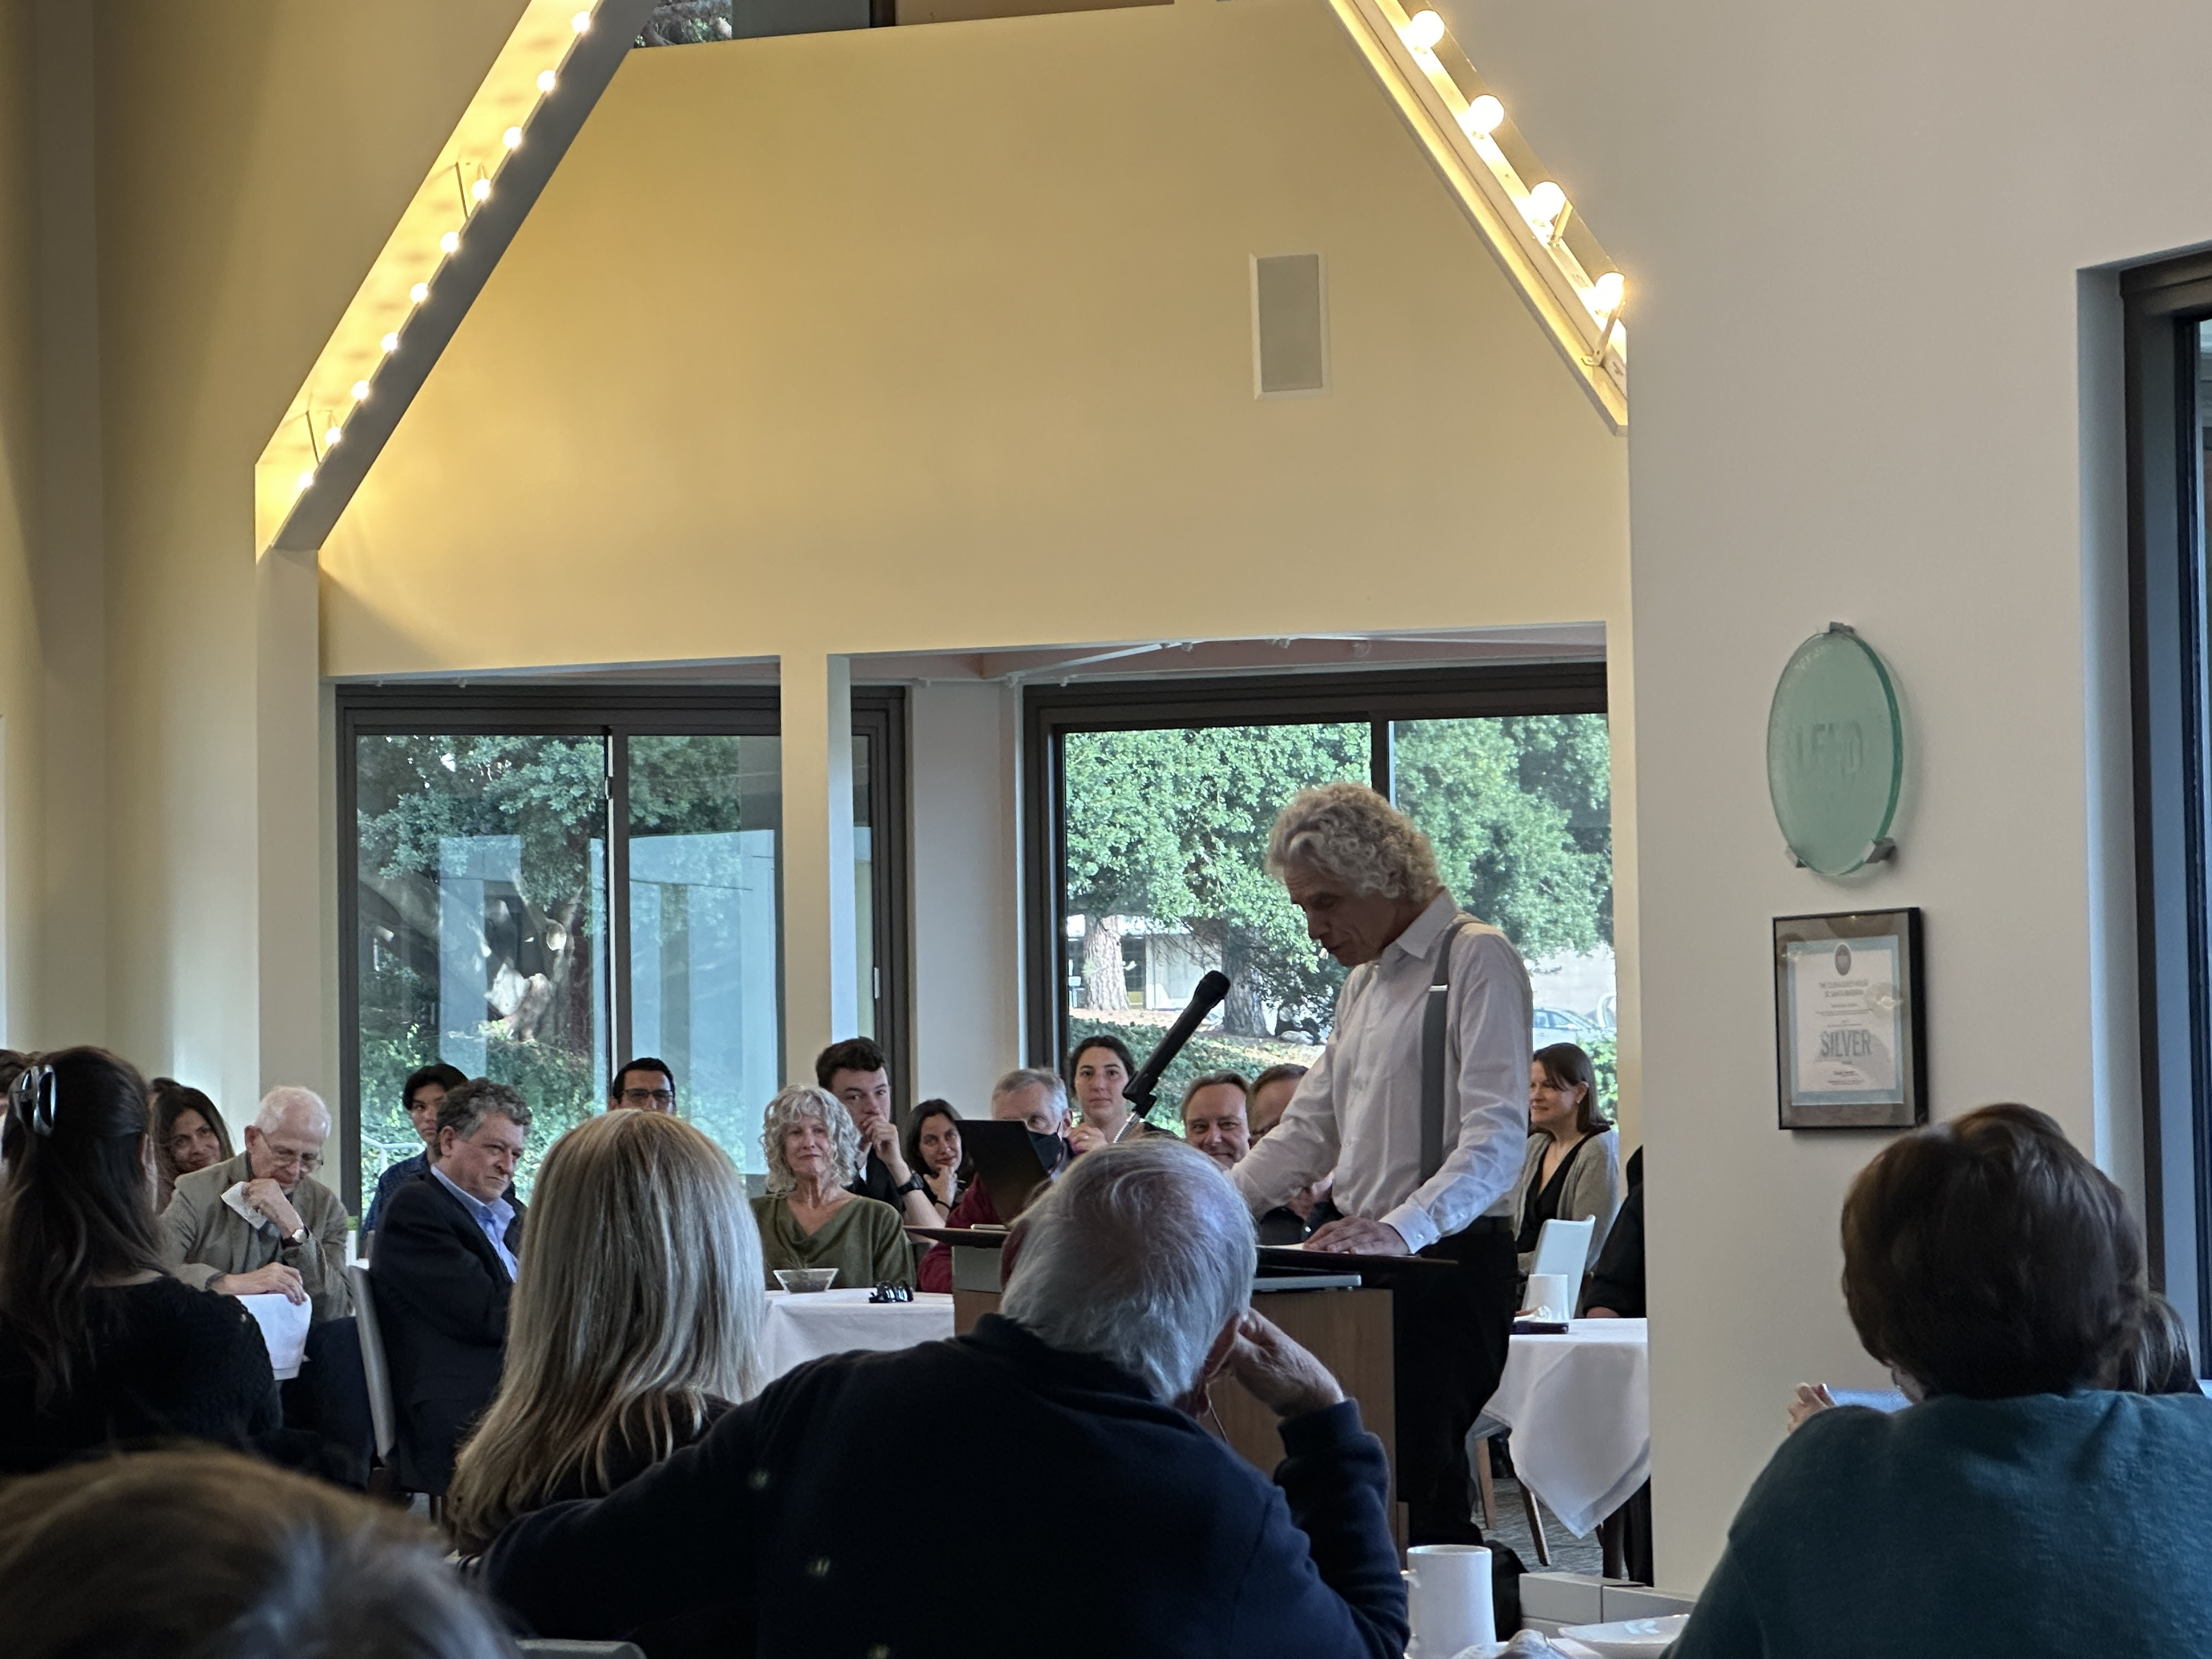
Notes:
Steve Pinker in Tooby-esque suspenders

Slide 3
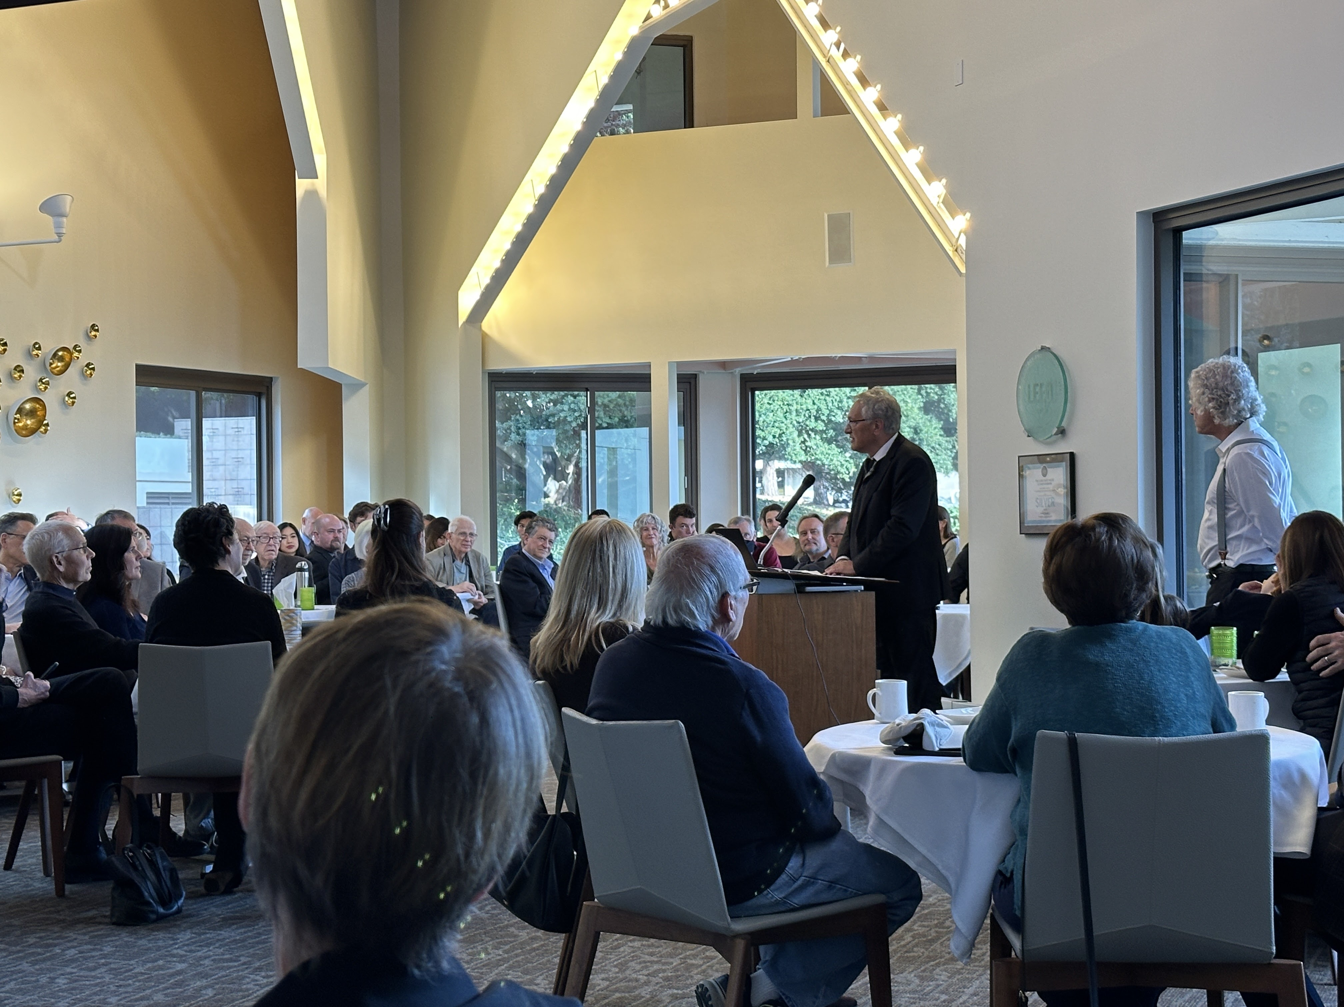
Notes:
Pascal Boyer

Slide 4
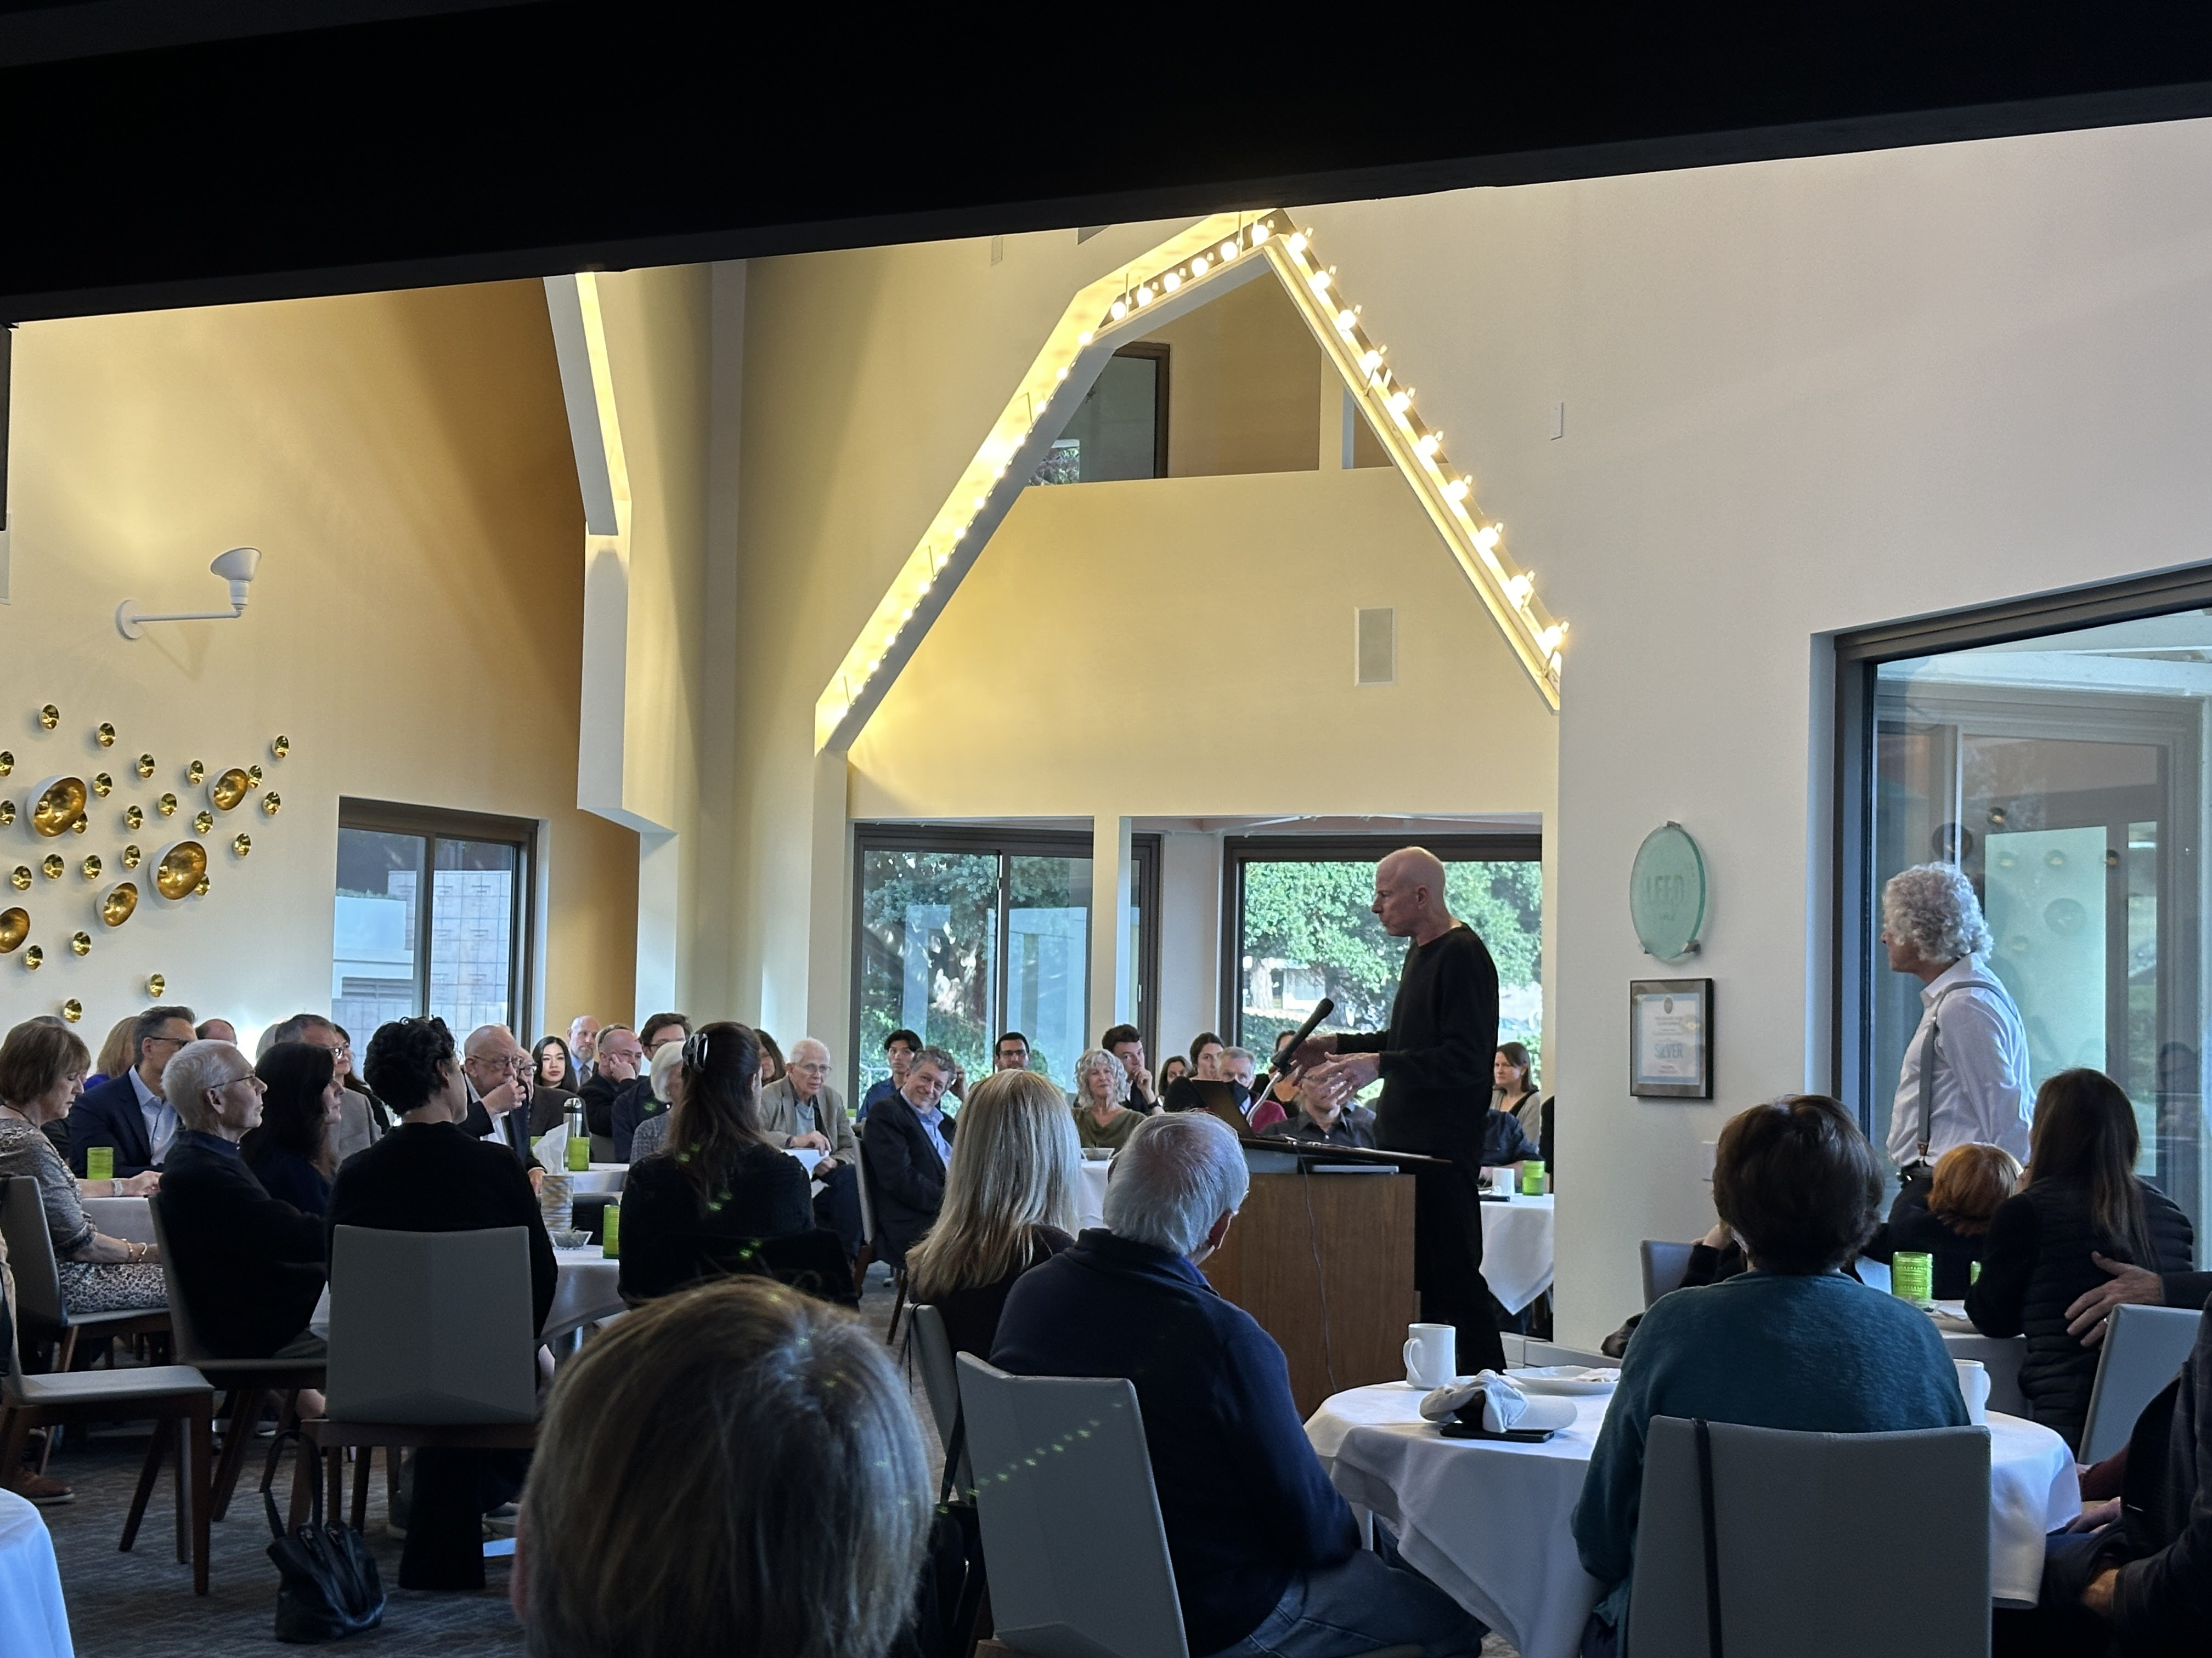
Notes:
David Buss

Slide 5
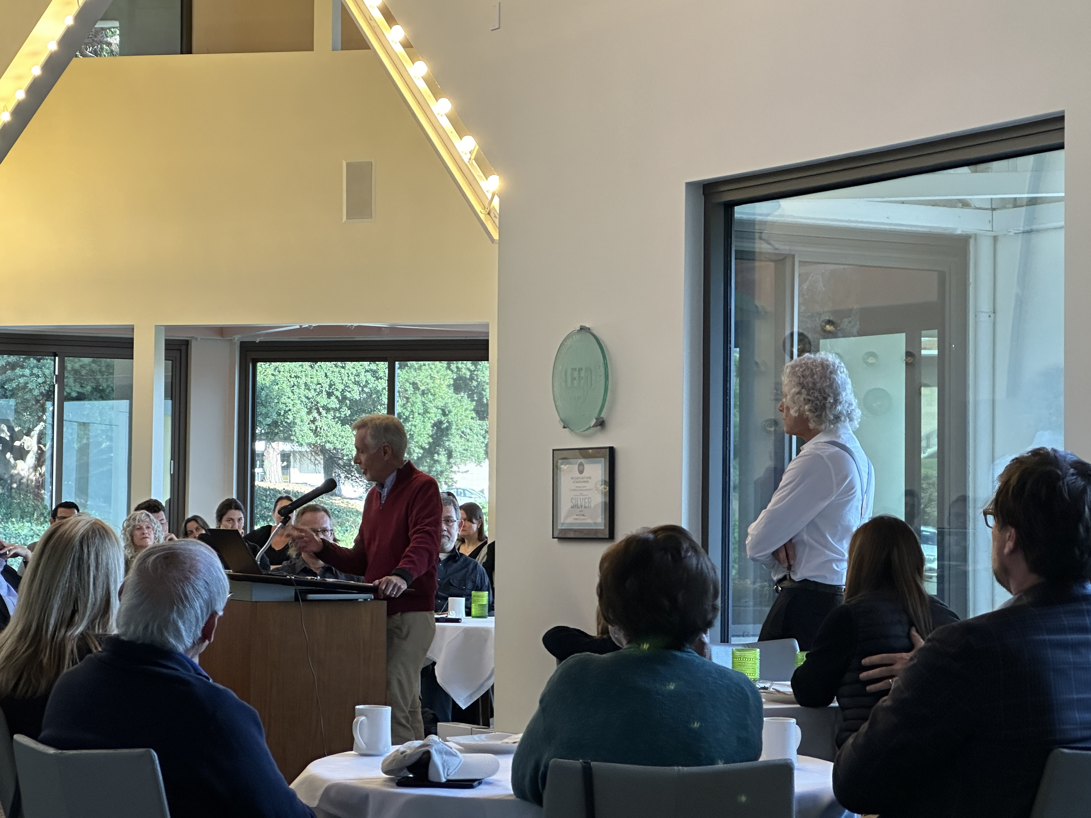
Notes:
Steve Gaulin

Slide 6
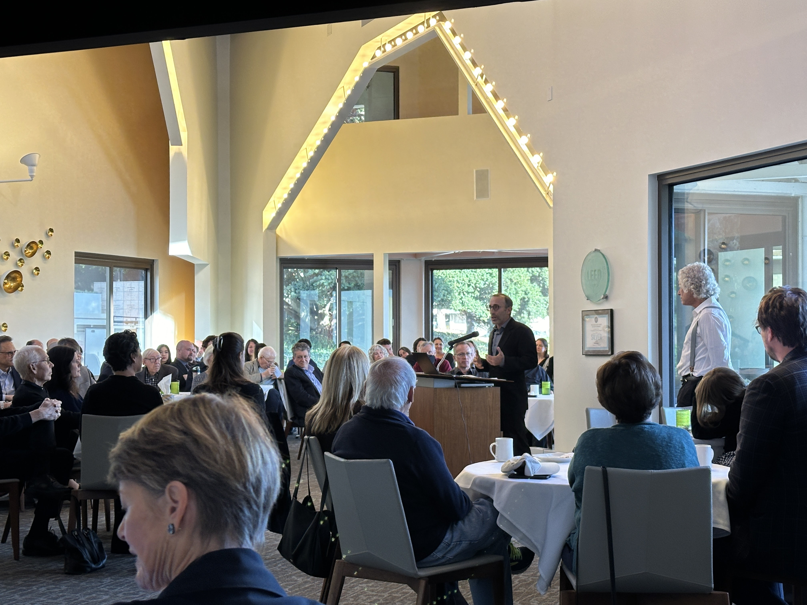
Notes:
Mike Gurven

Slide 7
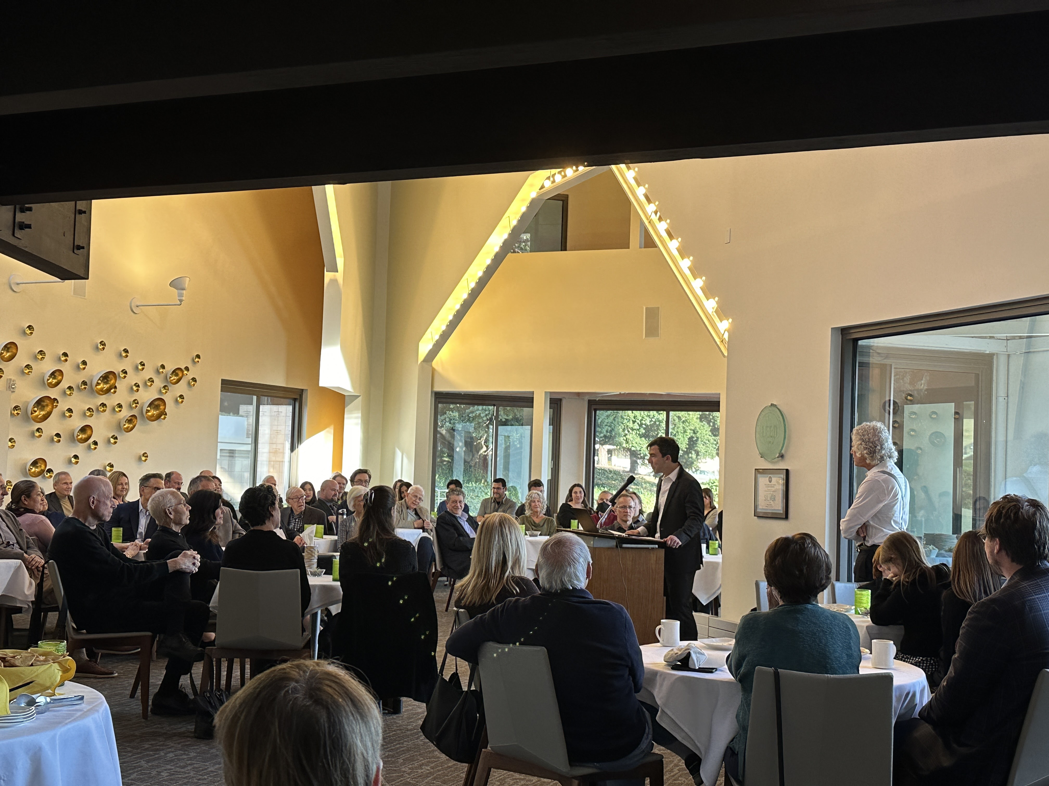
Notes:
Dave Pietraszewski

Slide 8
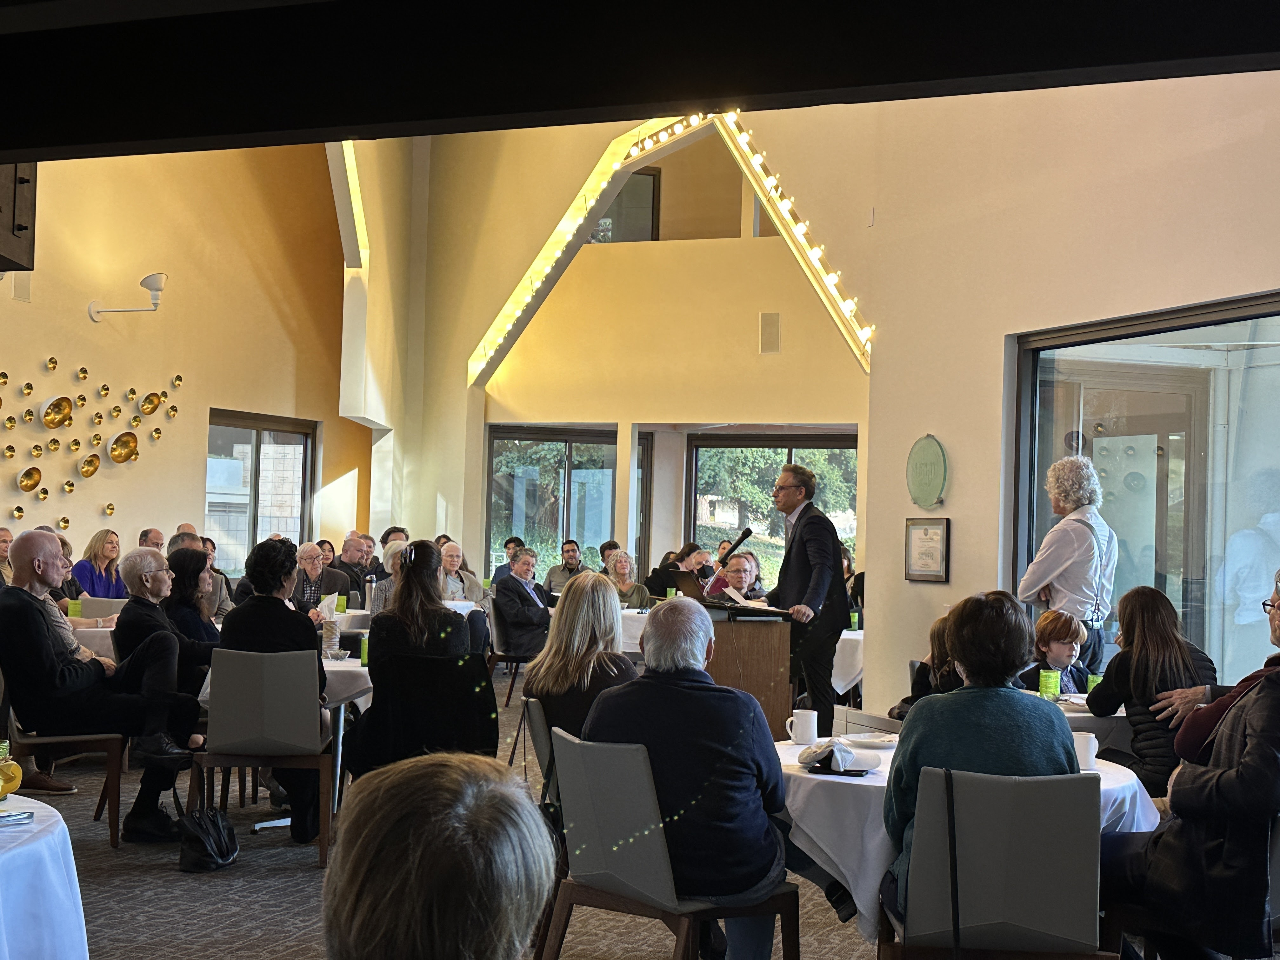
Notes:
Jordan Smoller

Slide 9
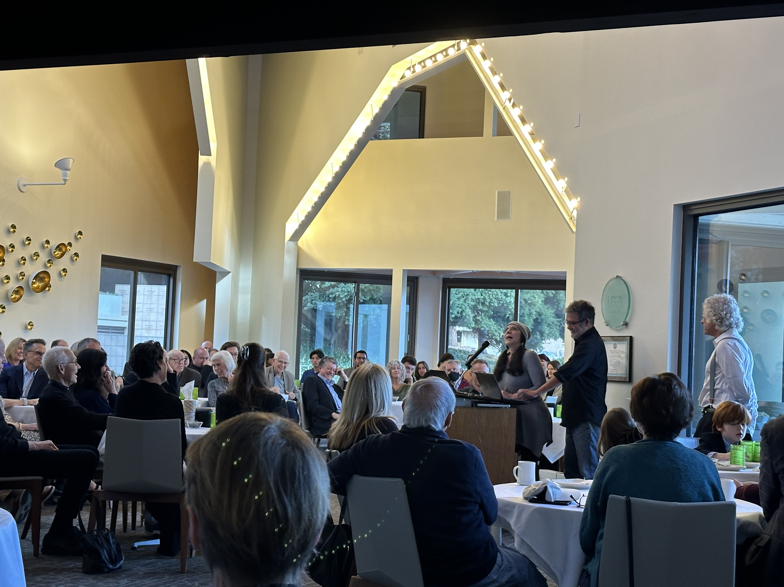
Notes:
Michelle Scalise Sugiyama and Larry Sugiyama

Slide 10
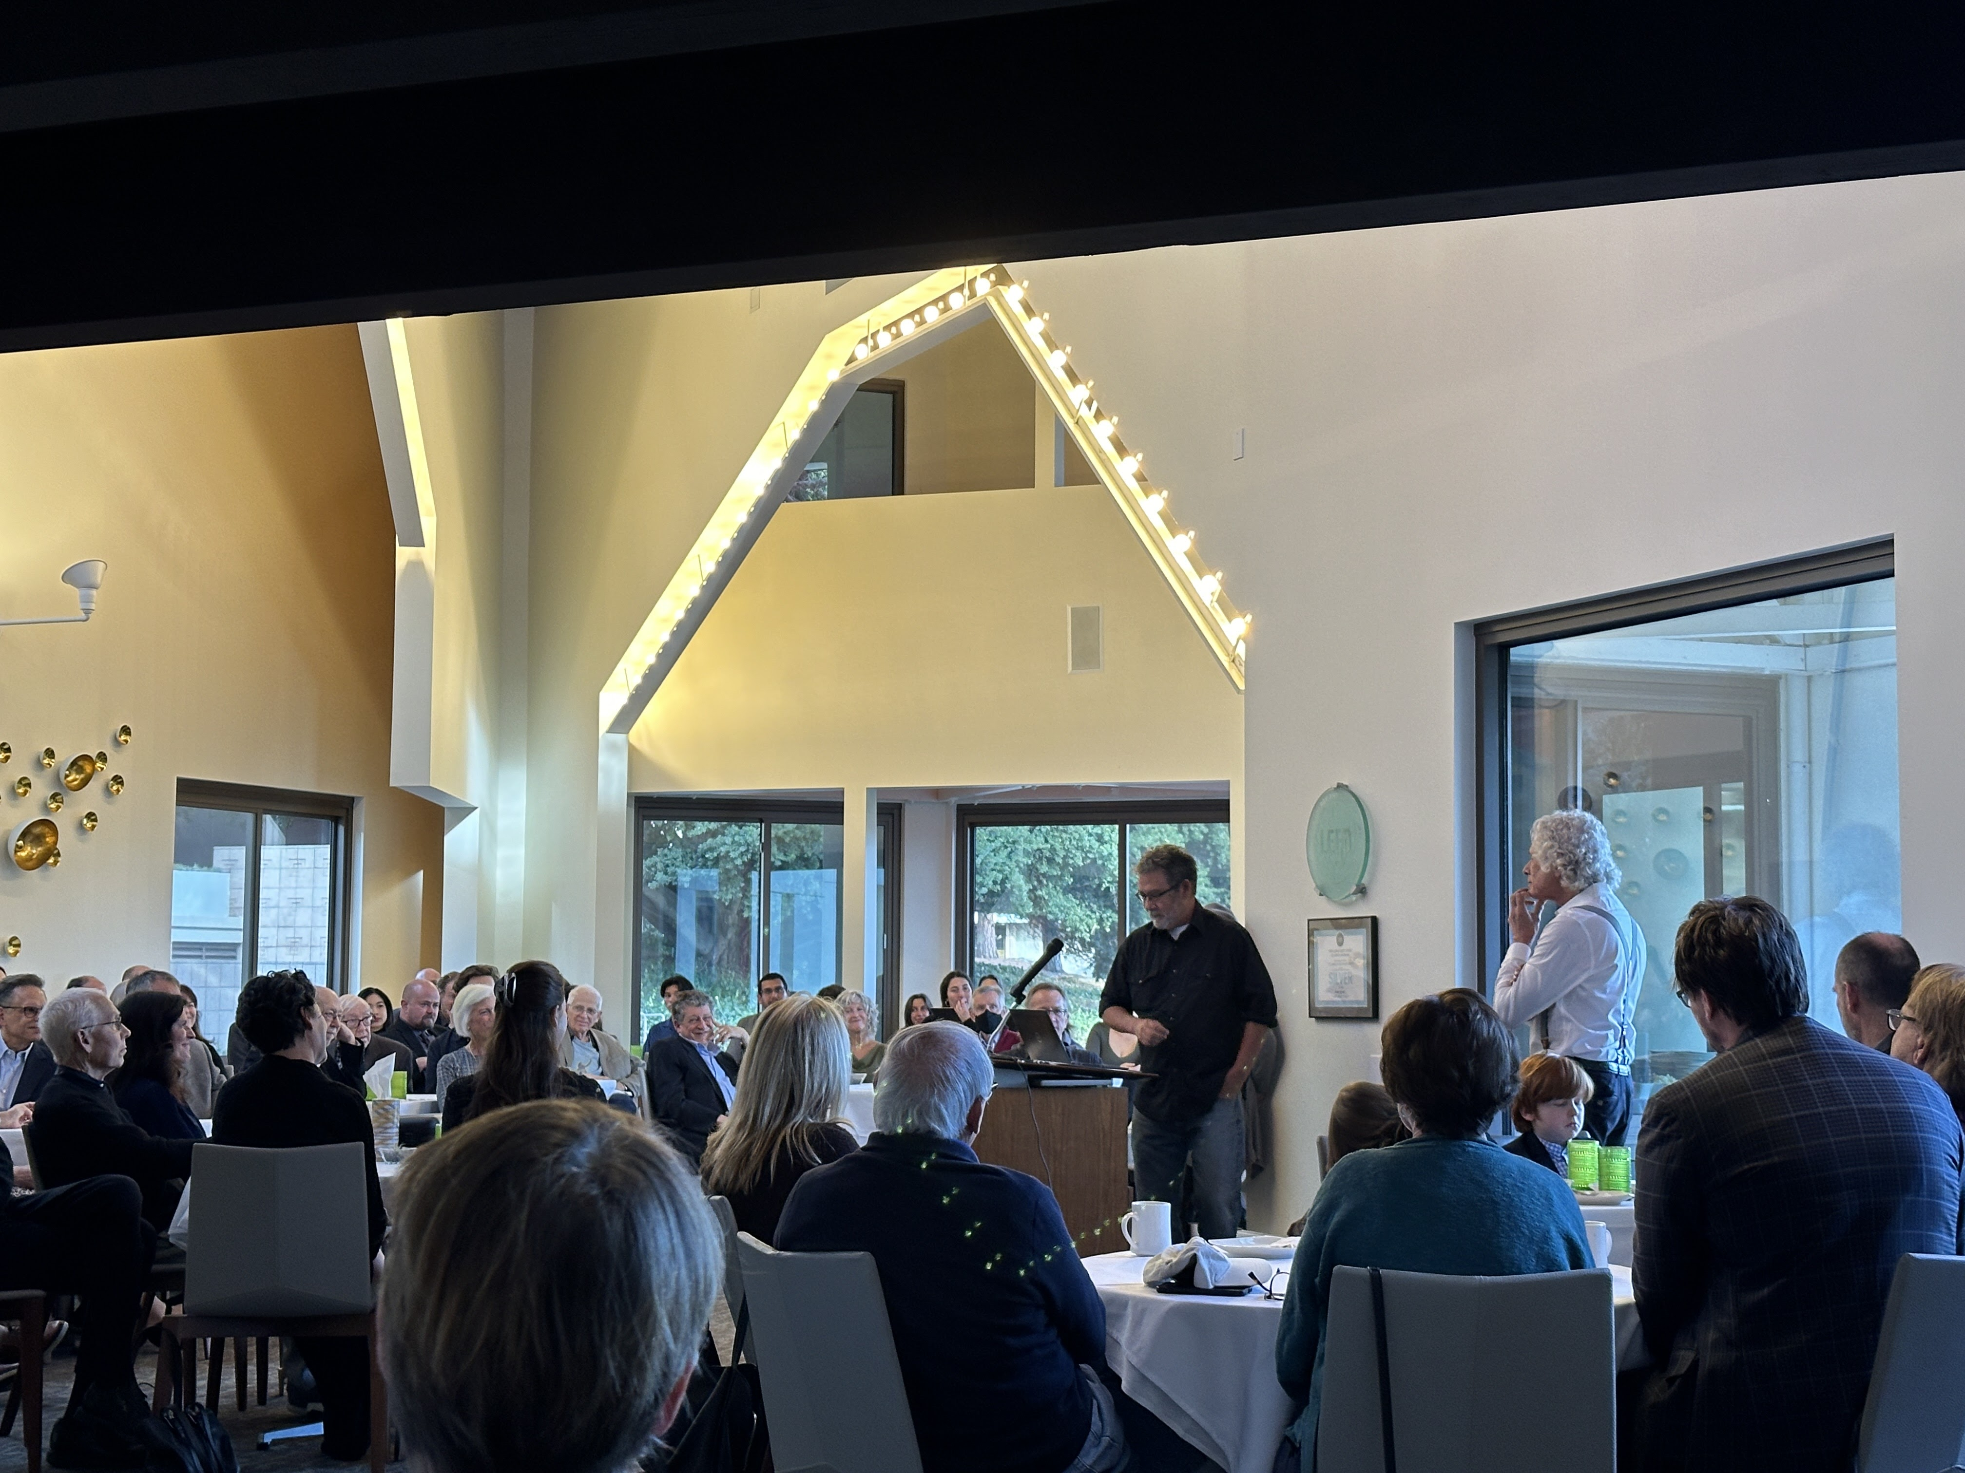
Notes:
Larry Sugiyama

Slide 11
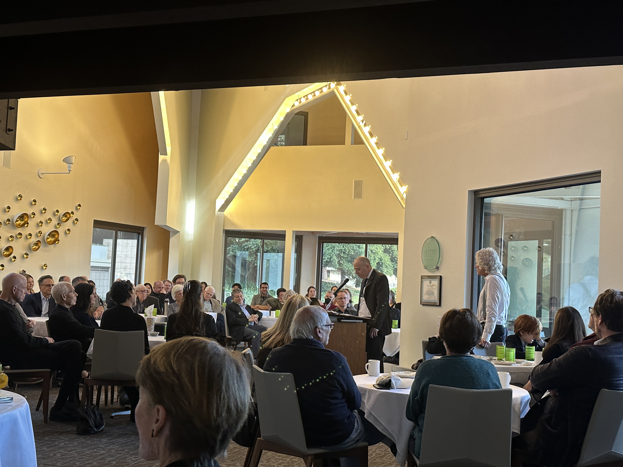
Notes:
Daniel Sznycer

Slide 12
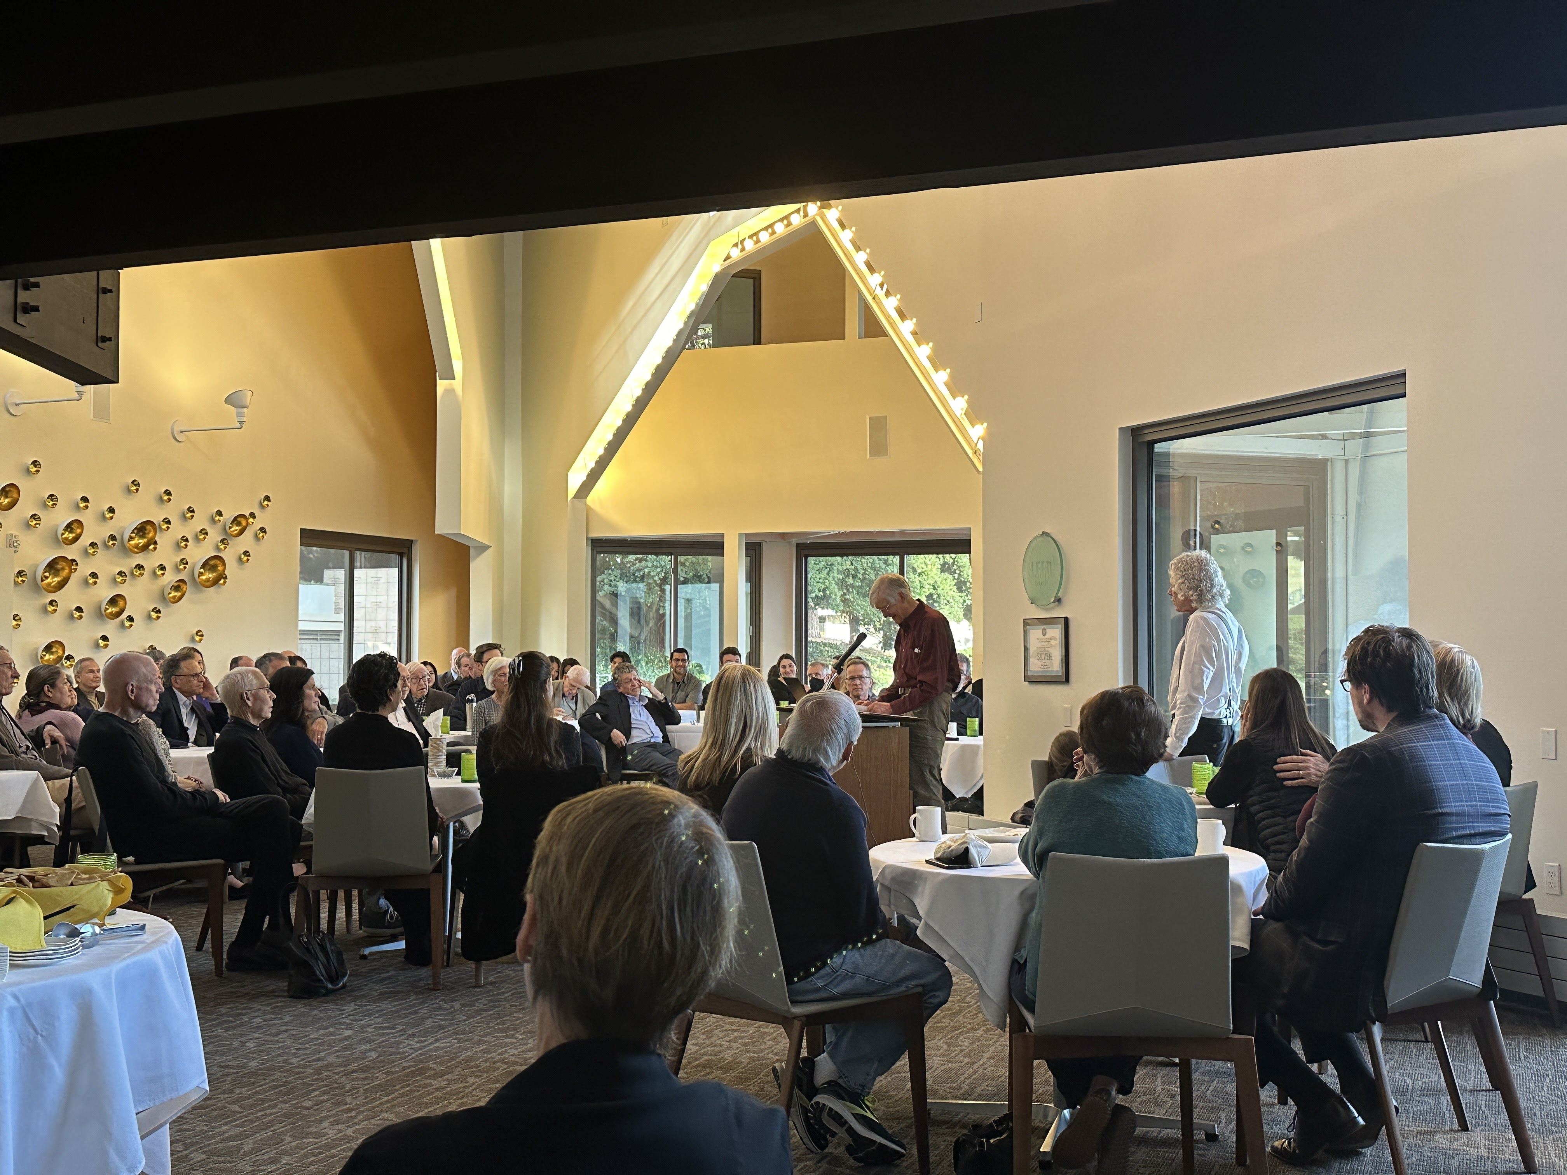
Notes:
Paul Tooby

Slide 13
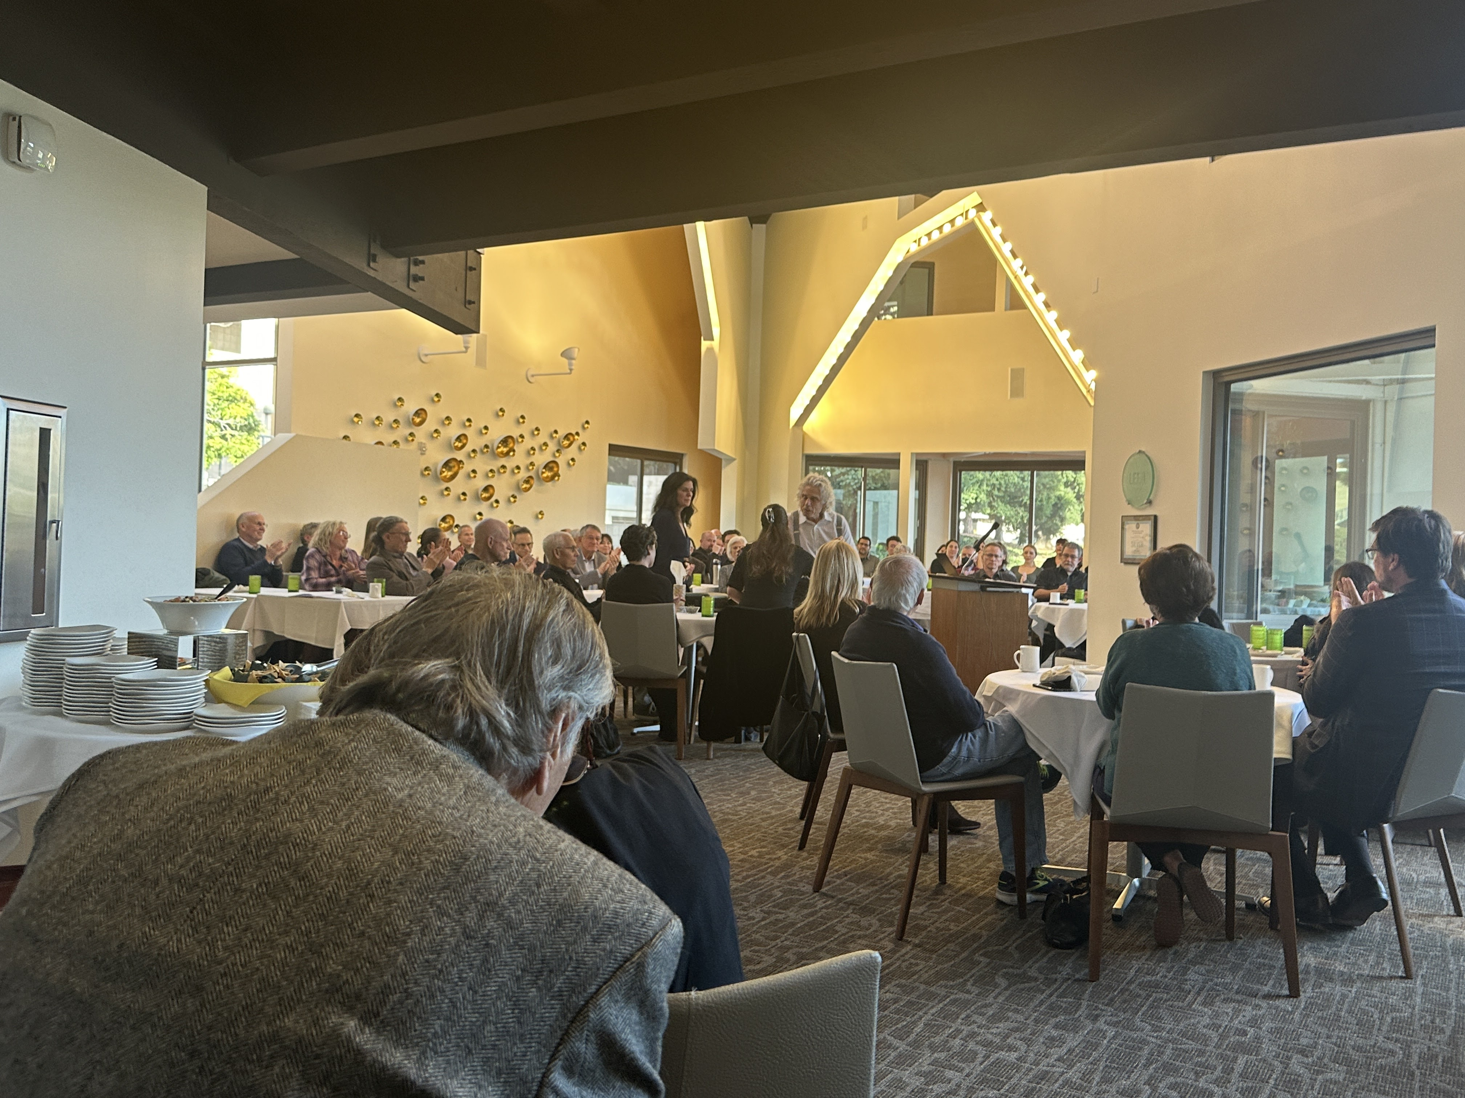
Notes:
Leda, Nike, Steve in center

Slide 14
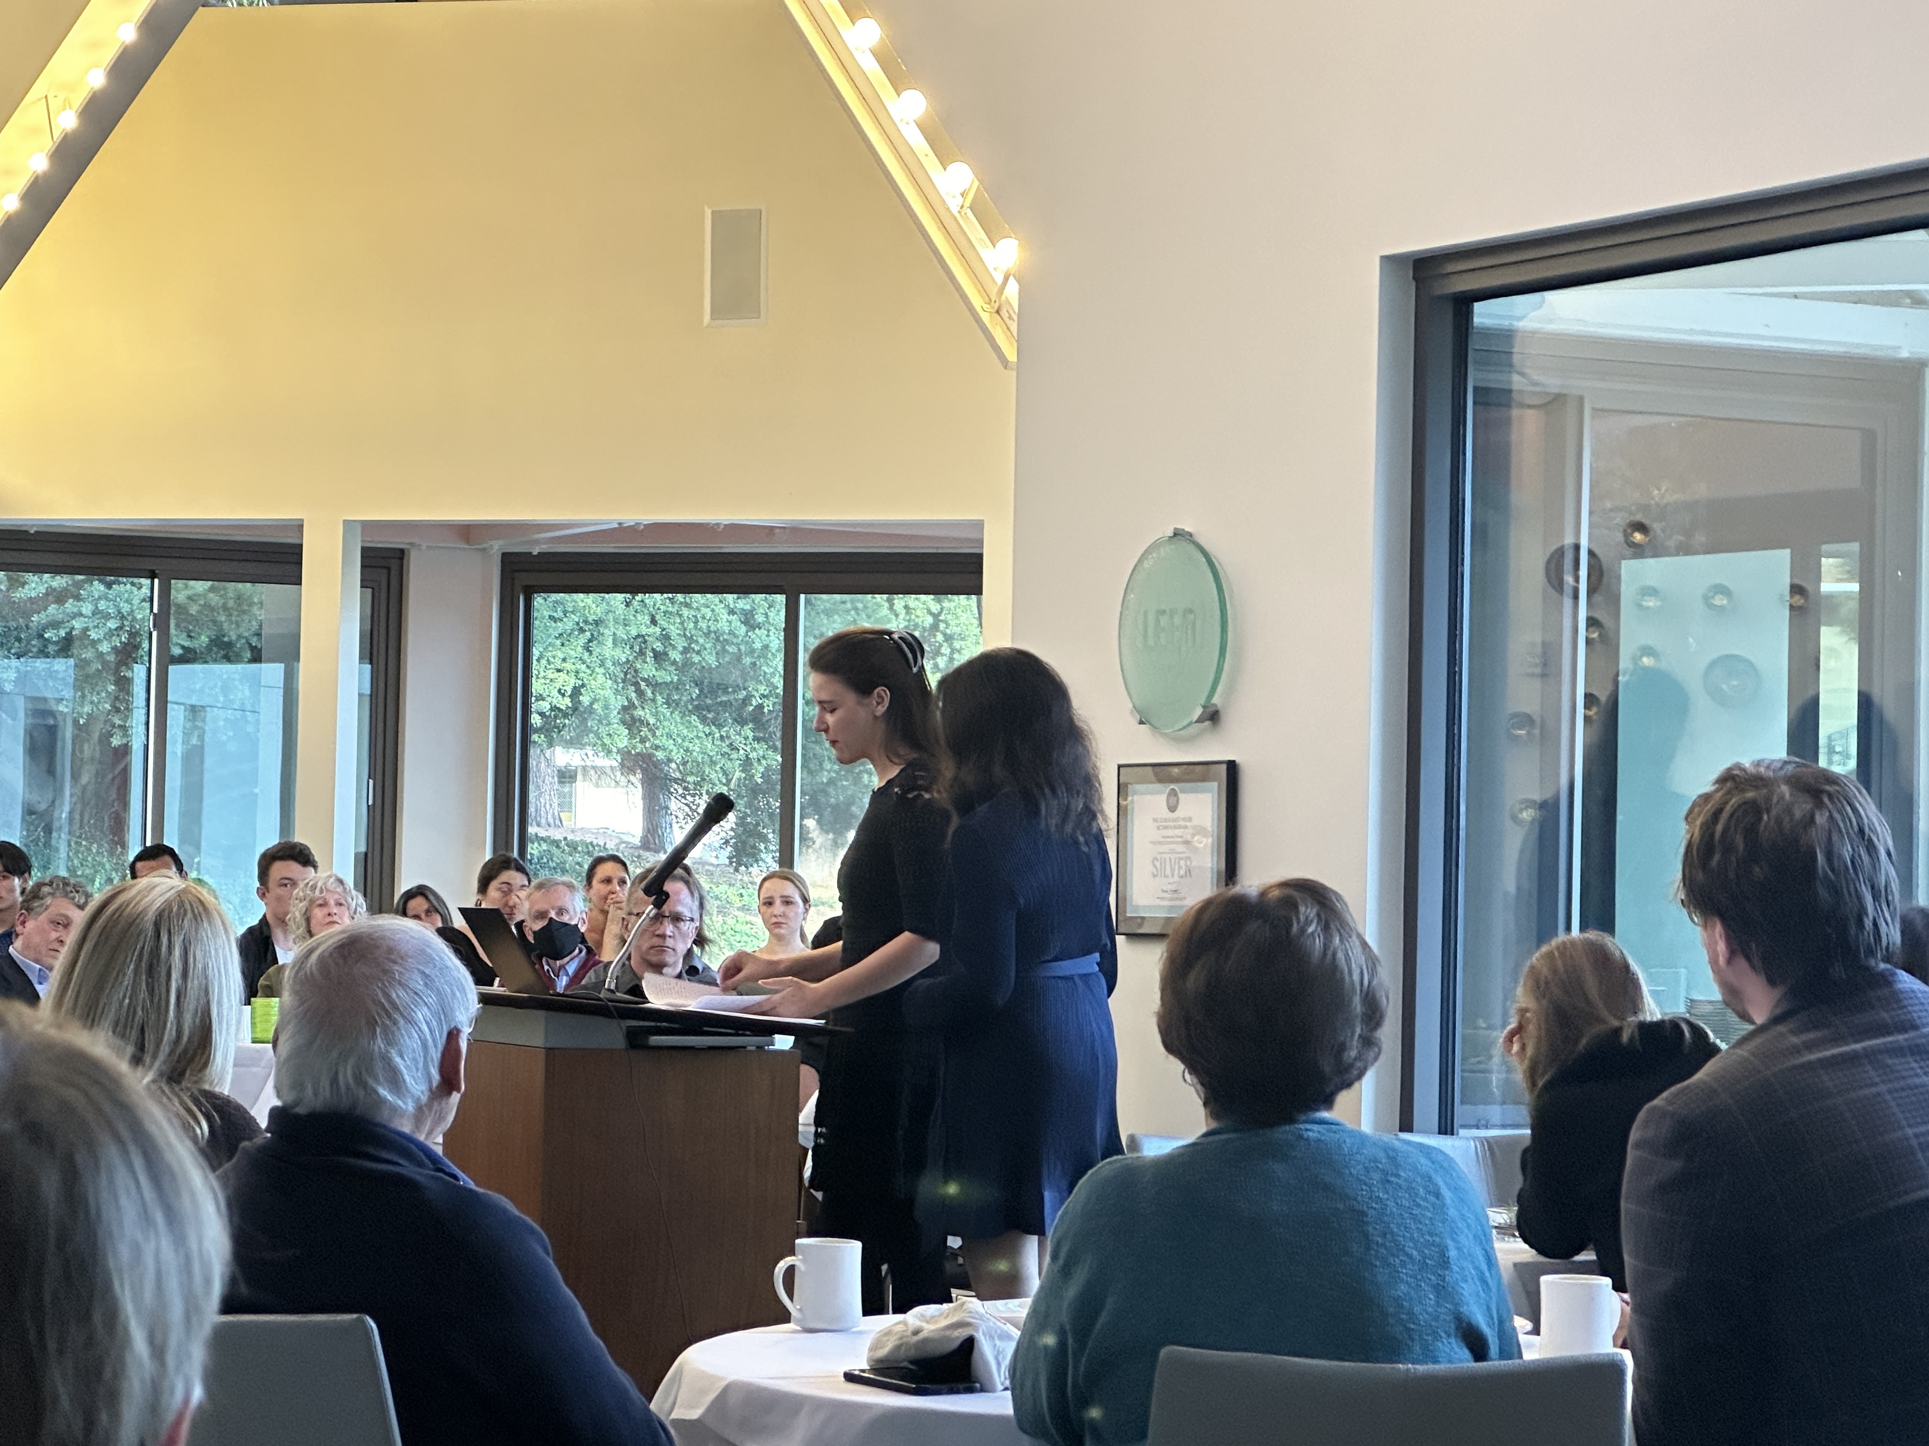
Notes:
Nike Tooby Cosmides

Slide 15
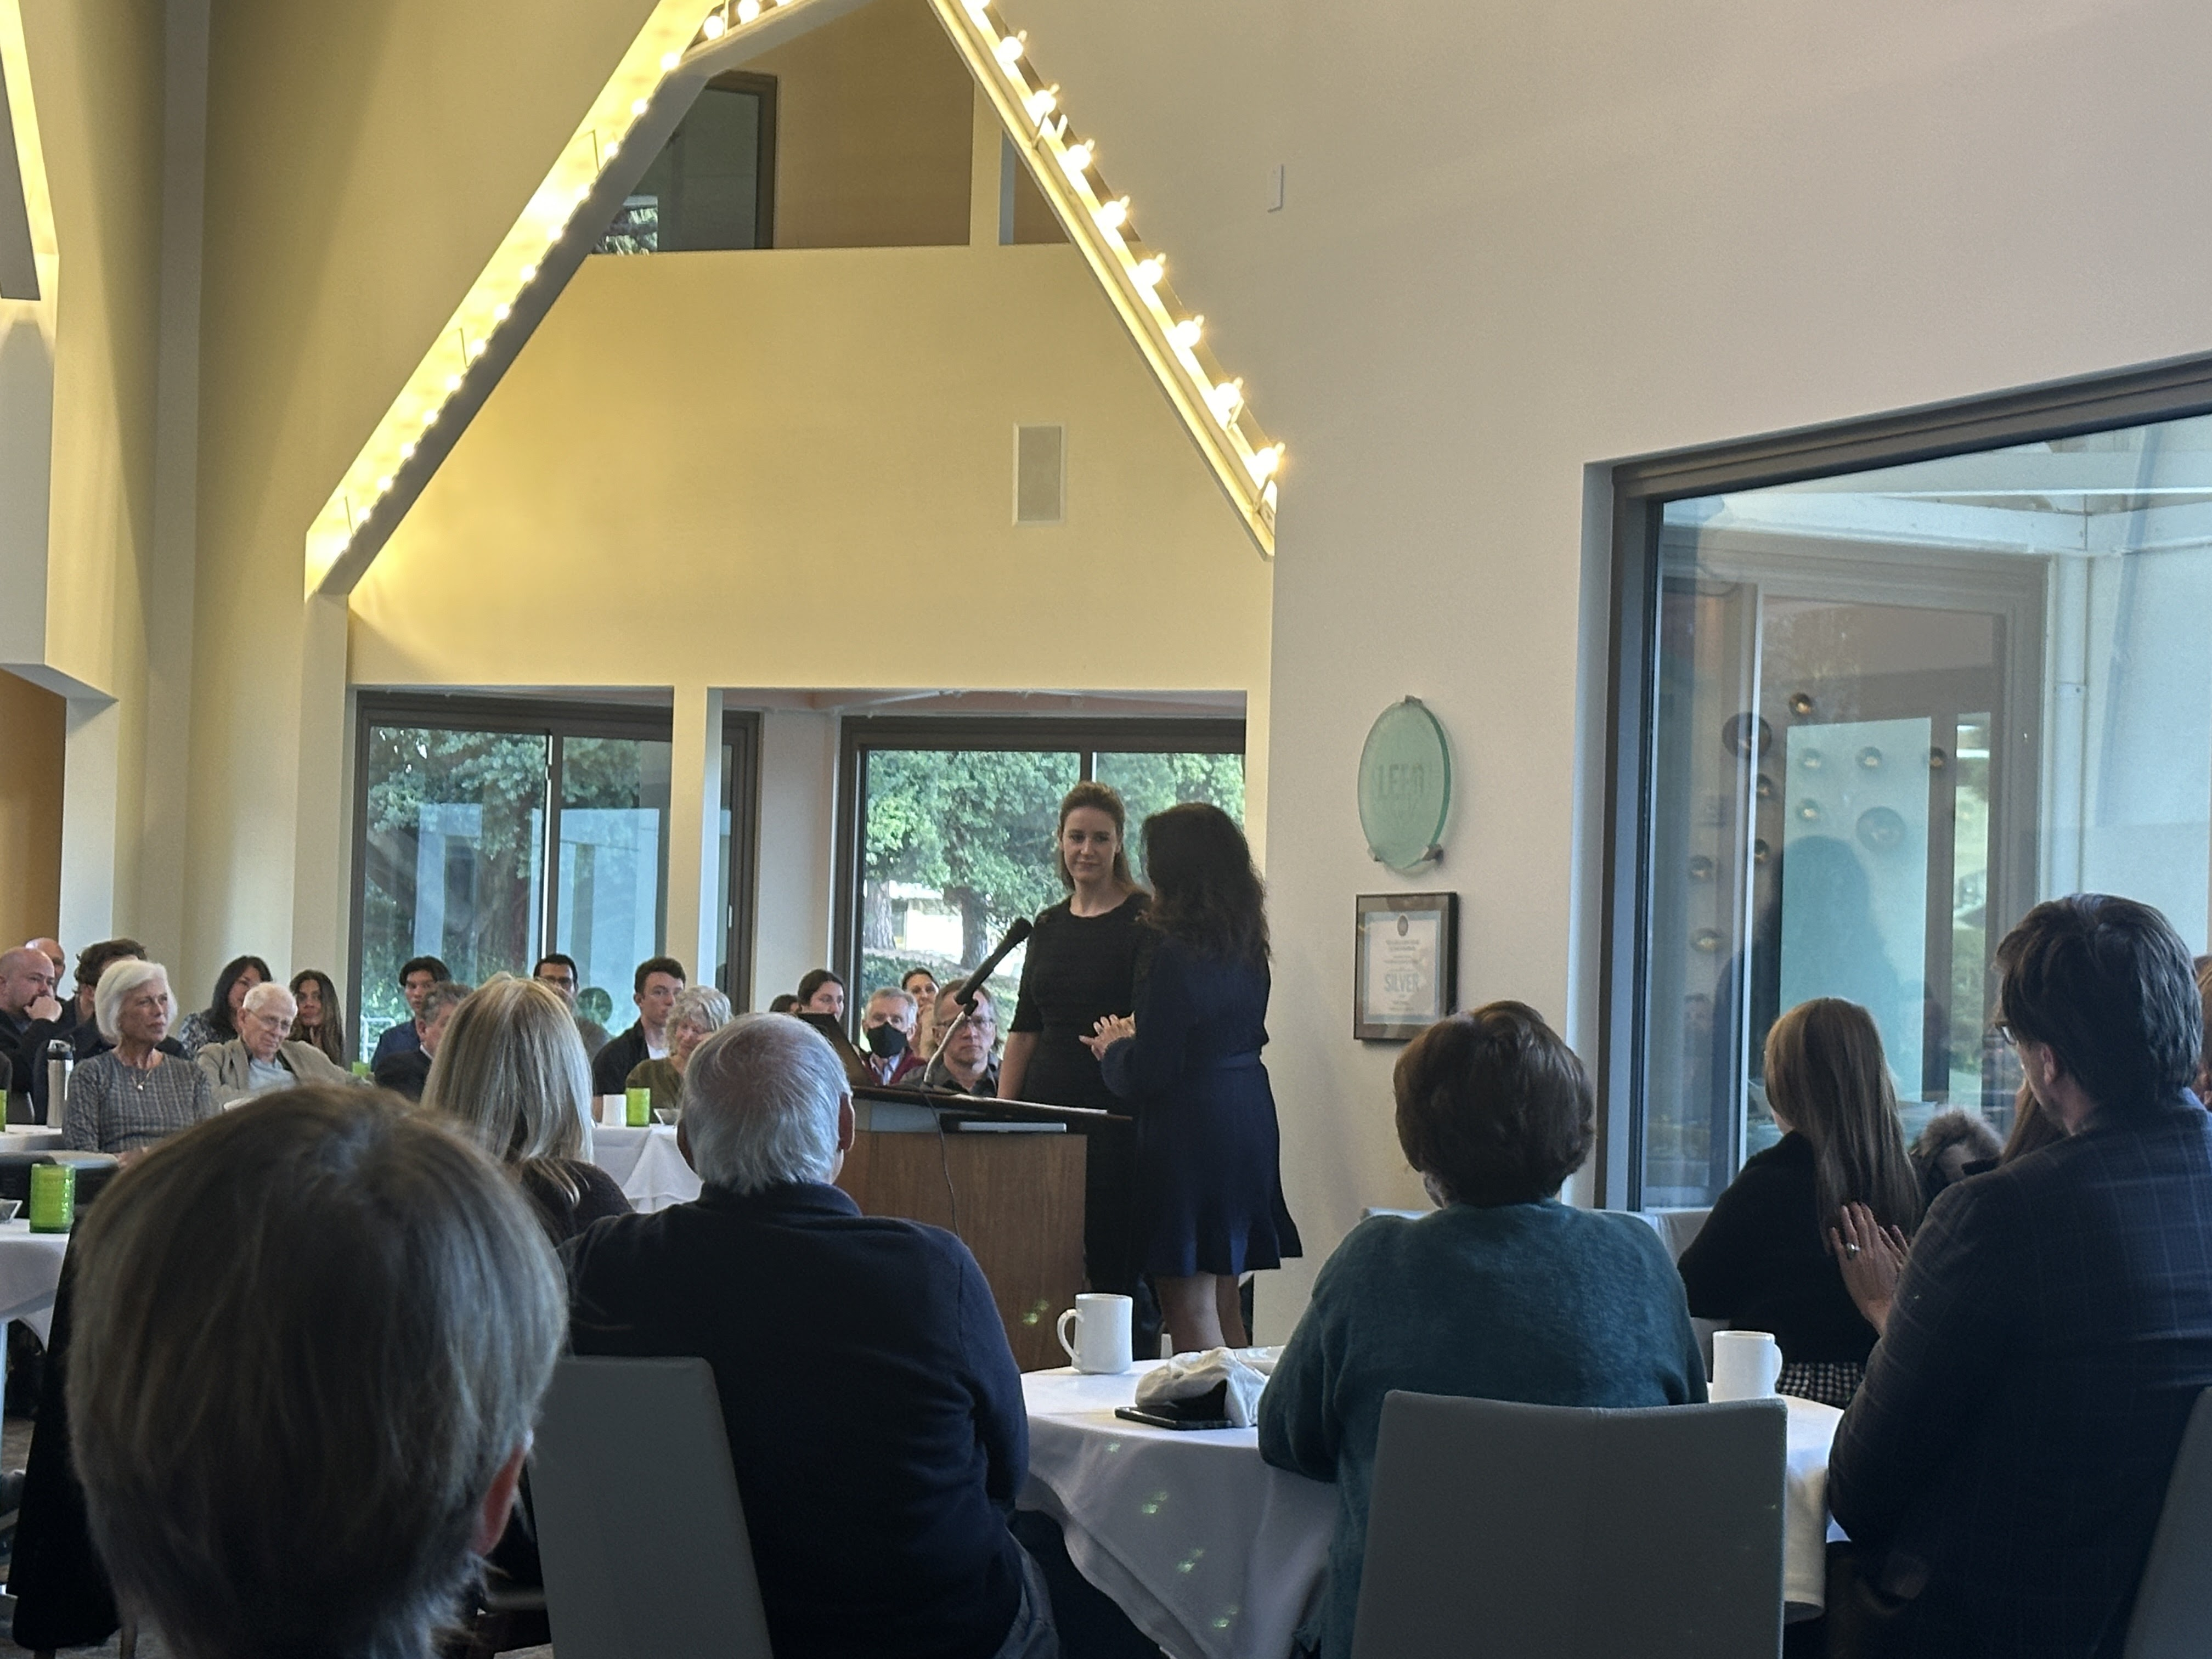

Slide 16
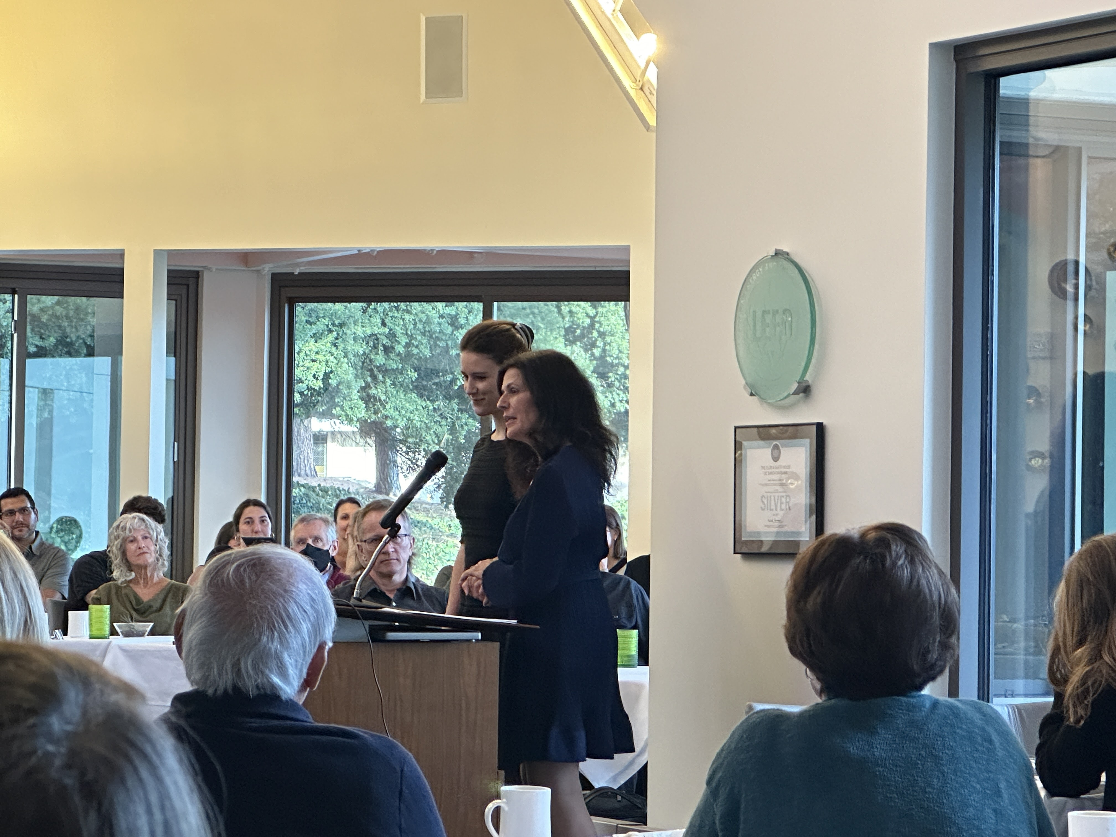
Notes:
Nike and Leda Cosmides

Slide 17
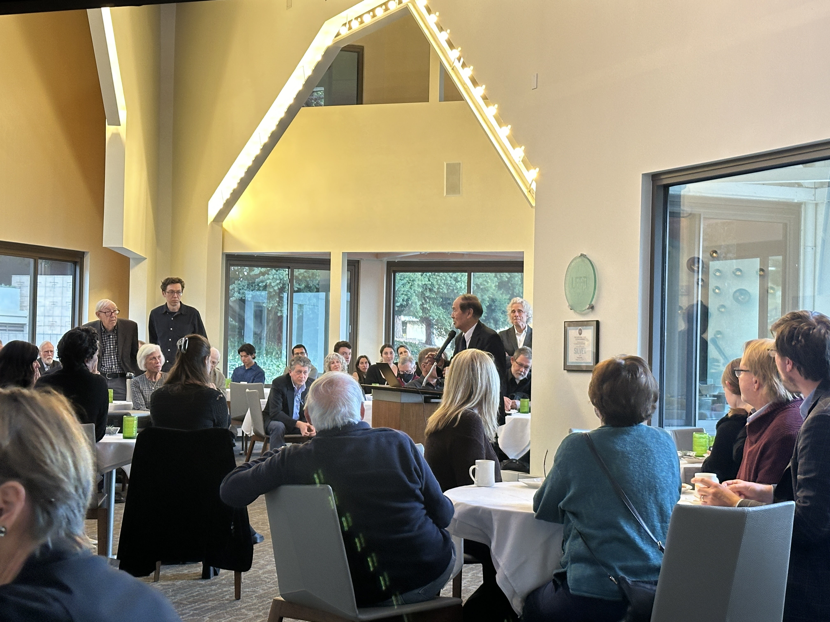
Notes:
Chancellor Henry Yang

Slide 18
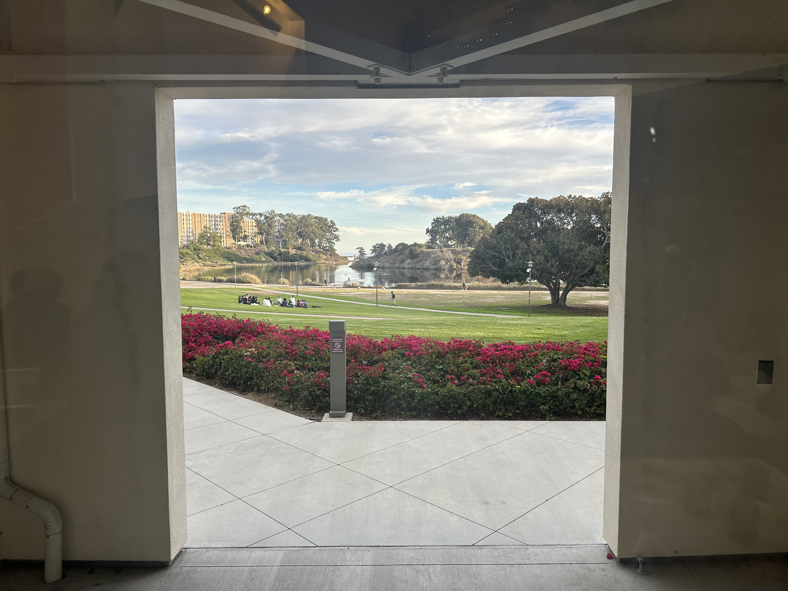
Notes:
Outside the UCSB Faculty Club, December 3, 2023

Slide 19
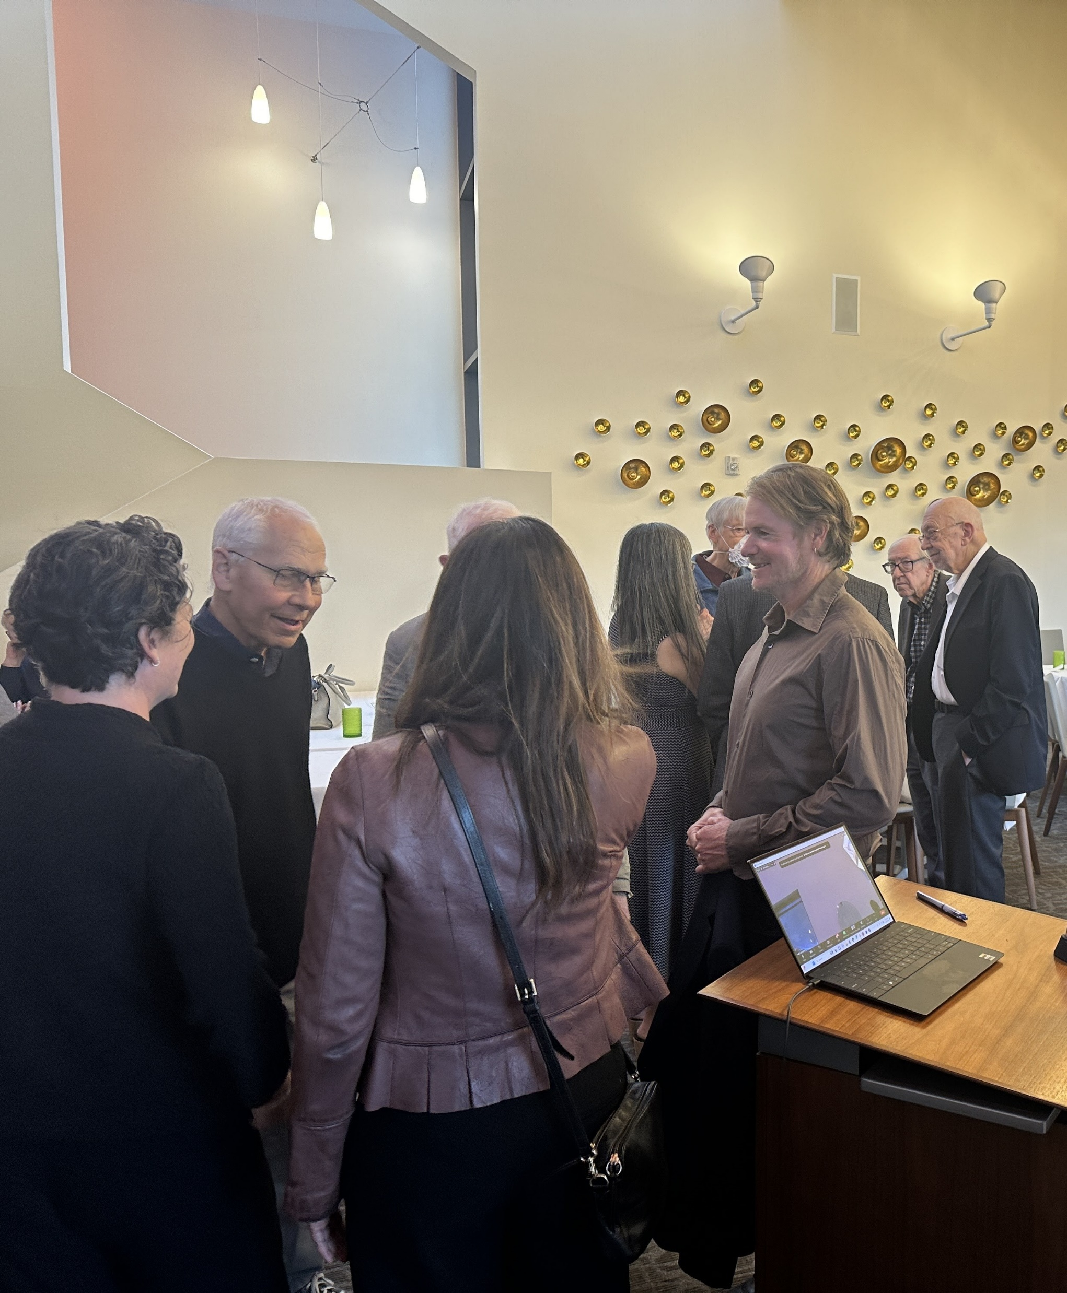
Notes:
Paulina Ospina, Don Symons, Maria Acosta, Miguel Eckstein. Tooby brothers in back

Slide 20
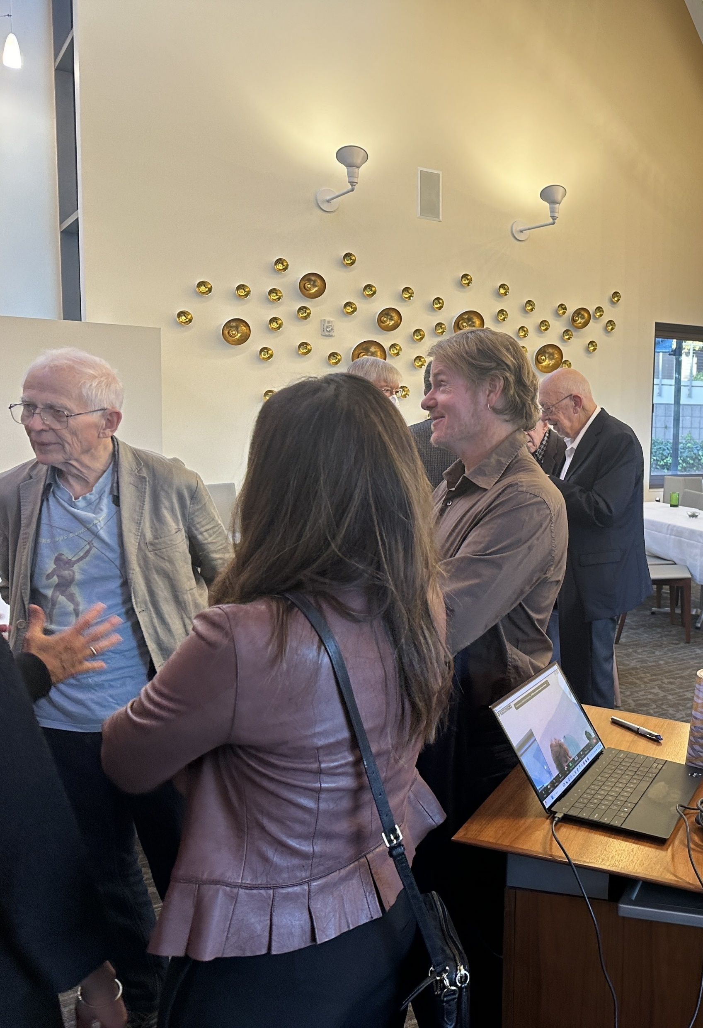
Notes:
Martin Daly in t-shirt from HBES 1995 in Santa Barbara, Maria Acosta, Miguel Eckstein, Norton Tooby

Slide 21
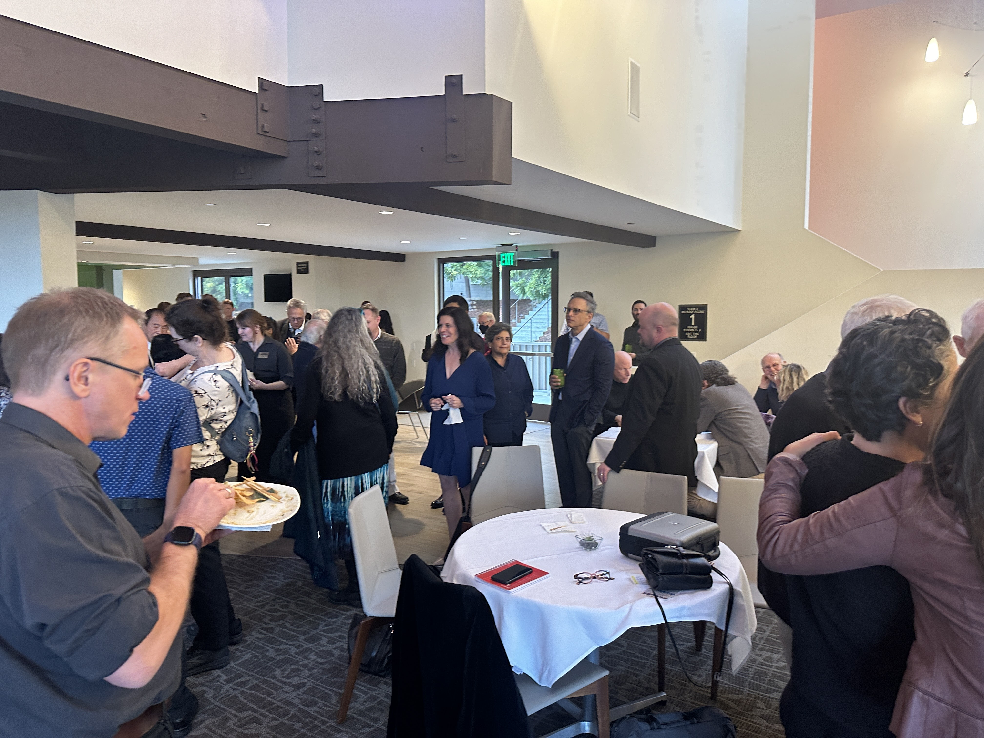

Slide 22
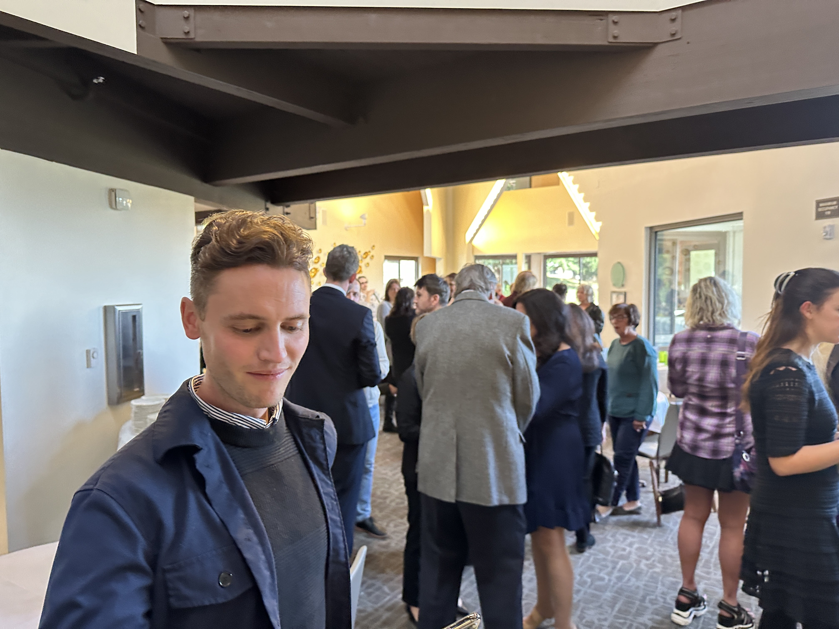
Notes:
Dylan Tweed

Slide 23
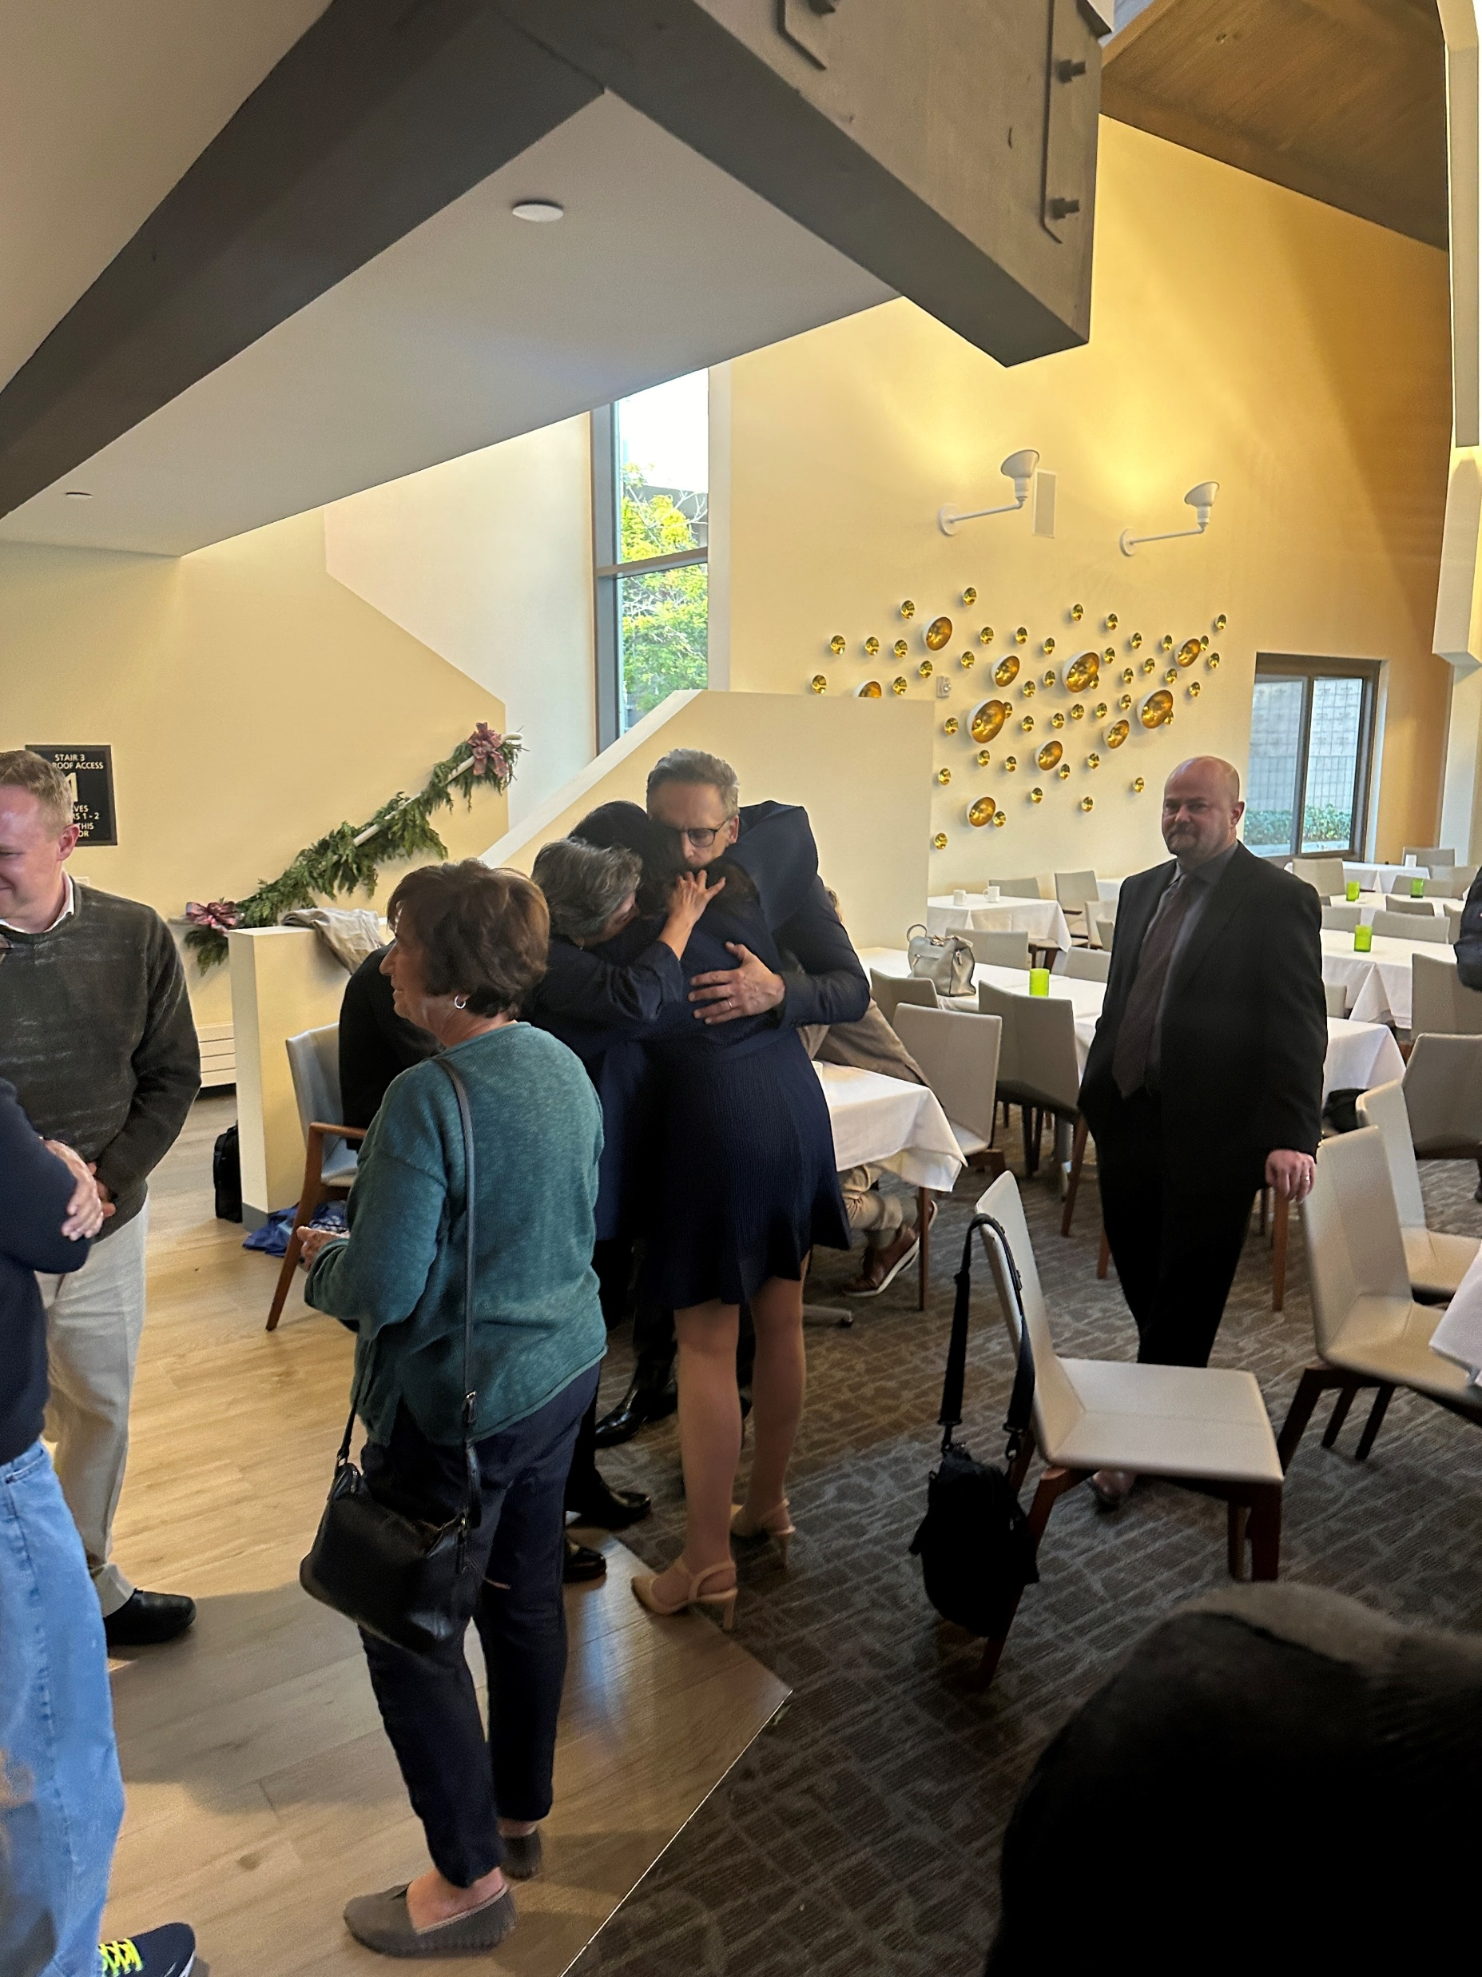
Notes:
Bev Mayer. Center: Naomi Rustomjee, Leda Cosmides, Jordan Smoller. Mel Rutherford

Slide 24
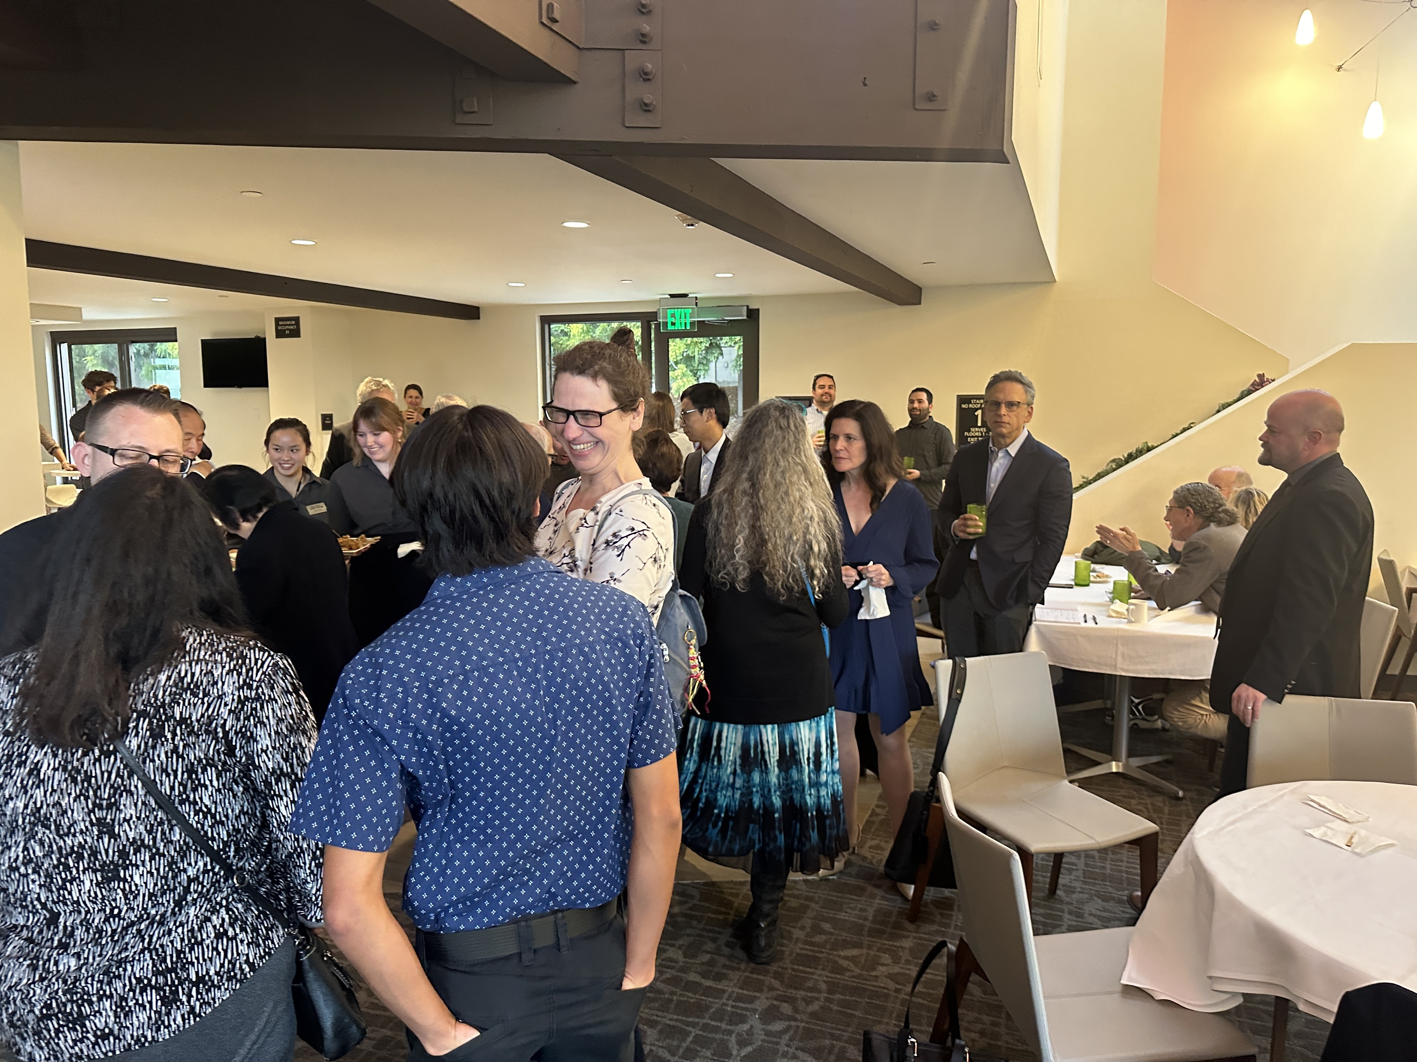

Slide 25
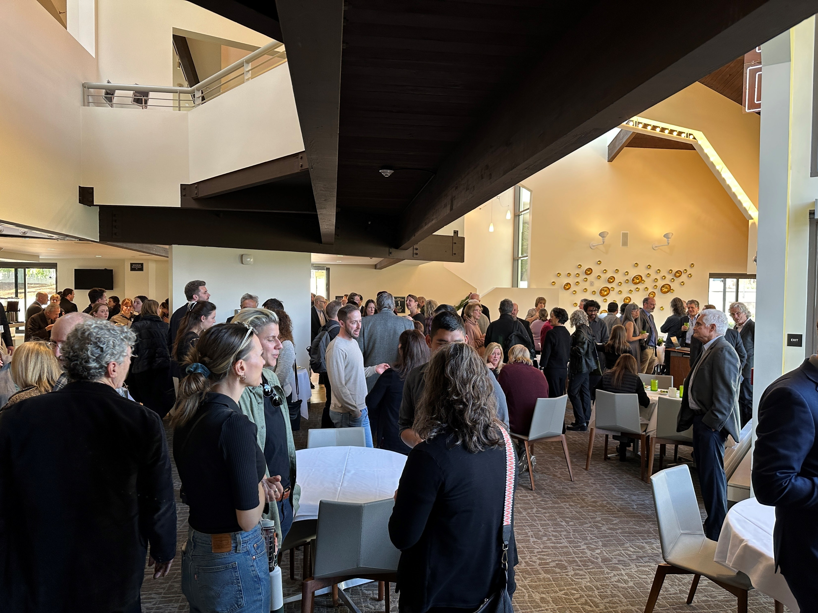
Notes:
In view: Steve Neuberg, Ronnie Bailey-Steinetz, Michael Barlev

Slide 26
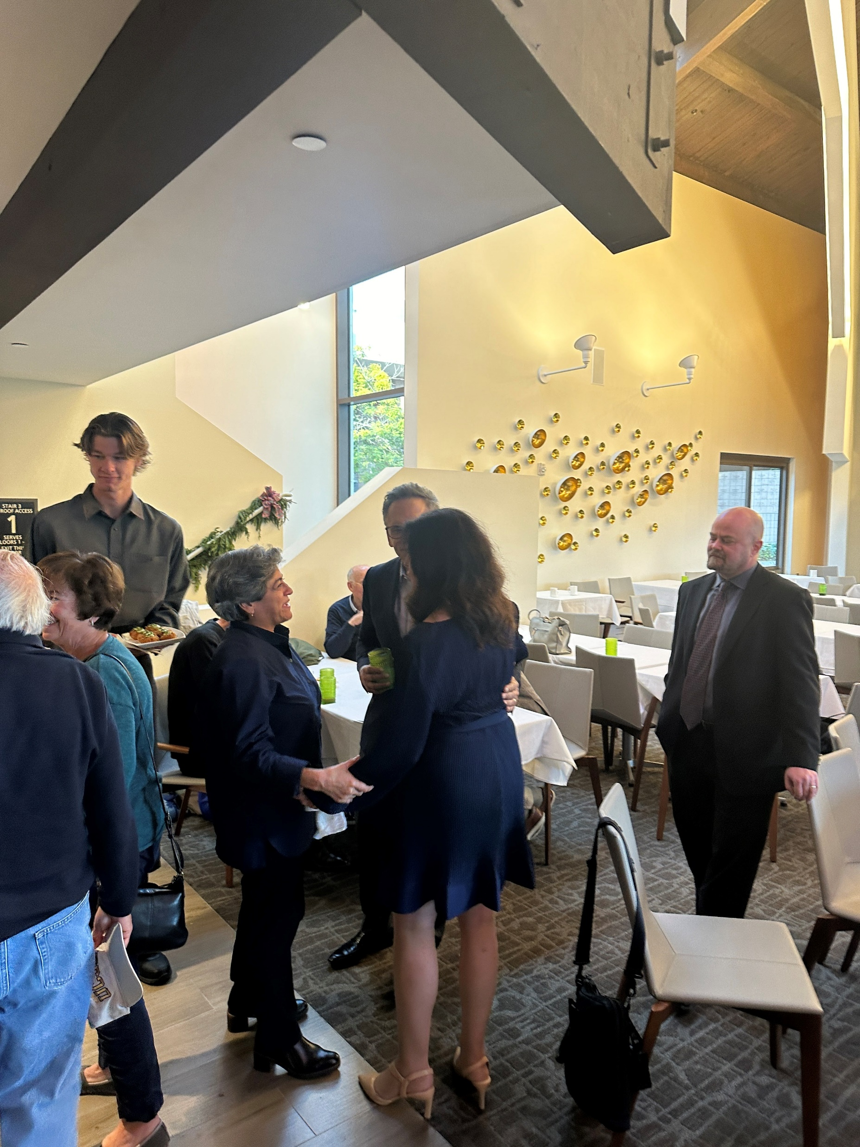

Slide 27
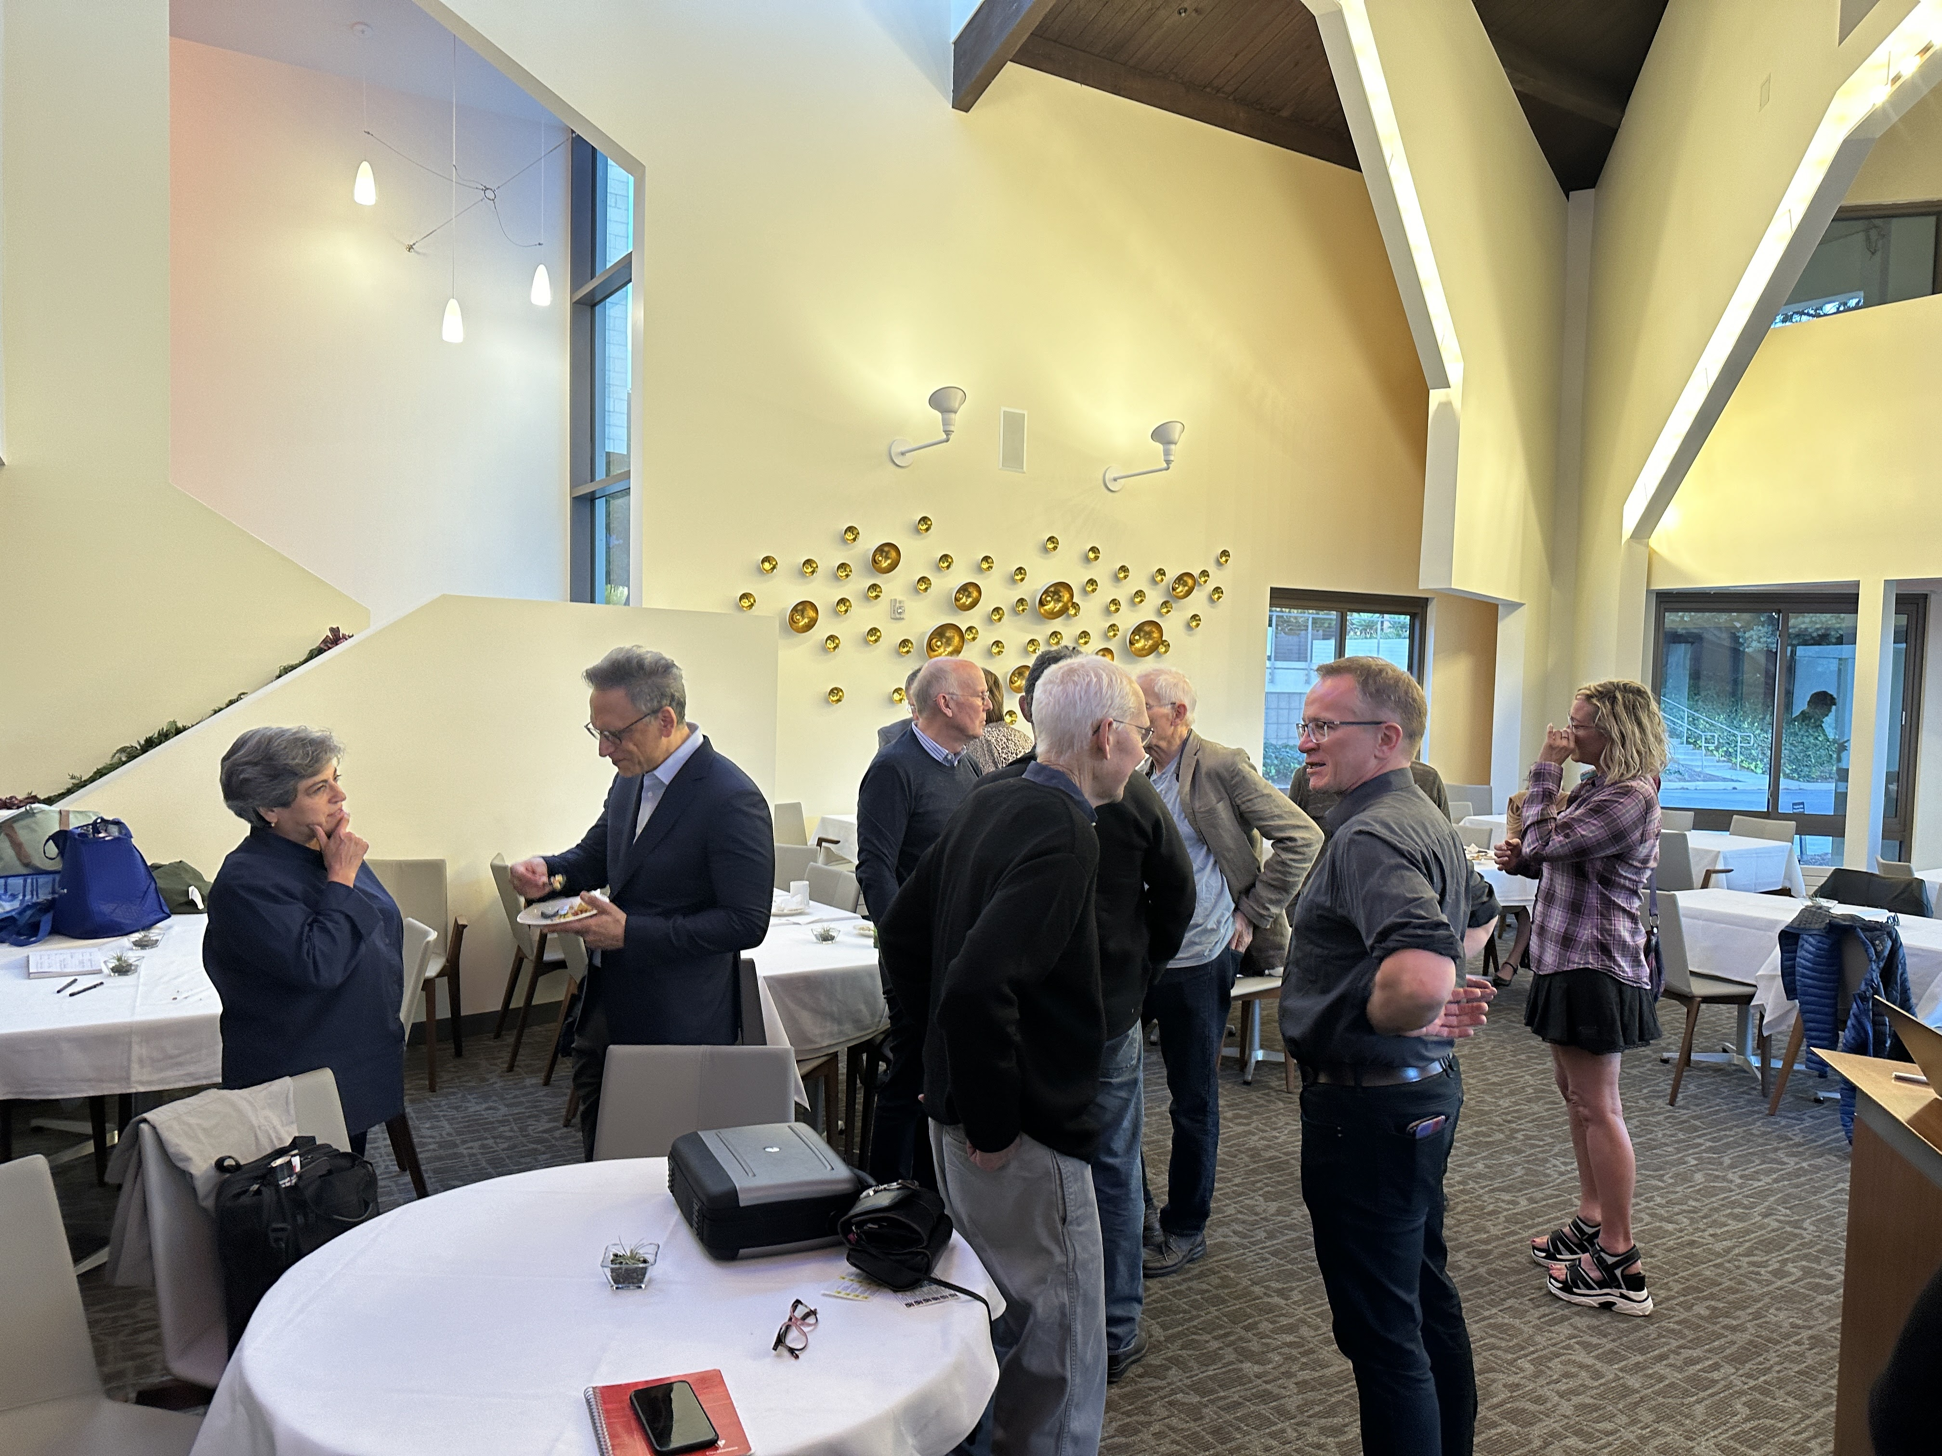
Notes:
Naomi Rustomjee, Jordan Smoller, Richard Wrangham, Don Symons, Martin Daly, Larry Fiddick, Catherine Salmon

Slide 28
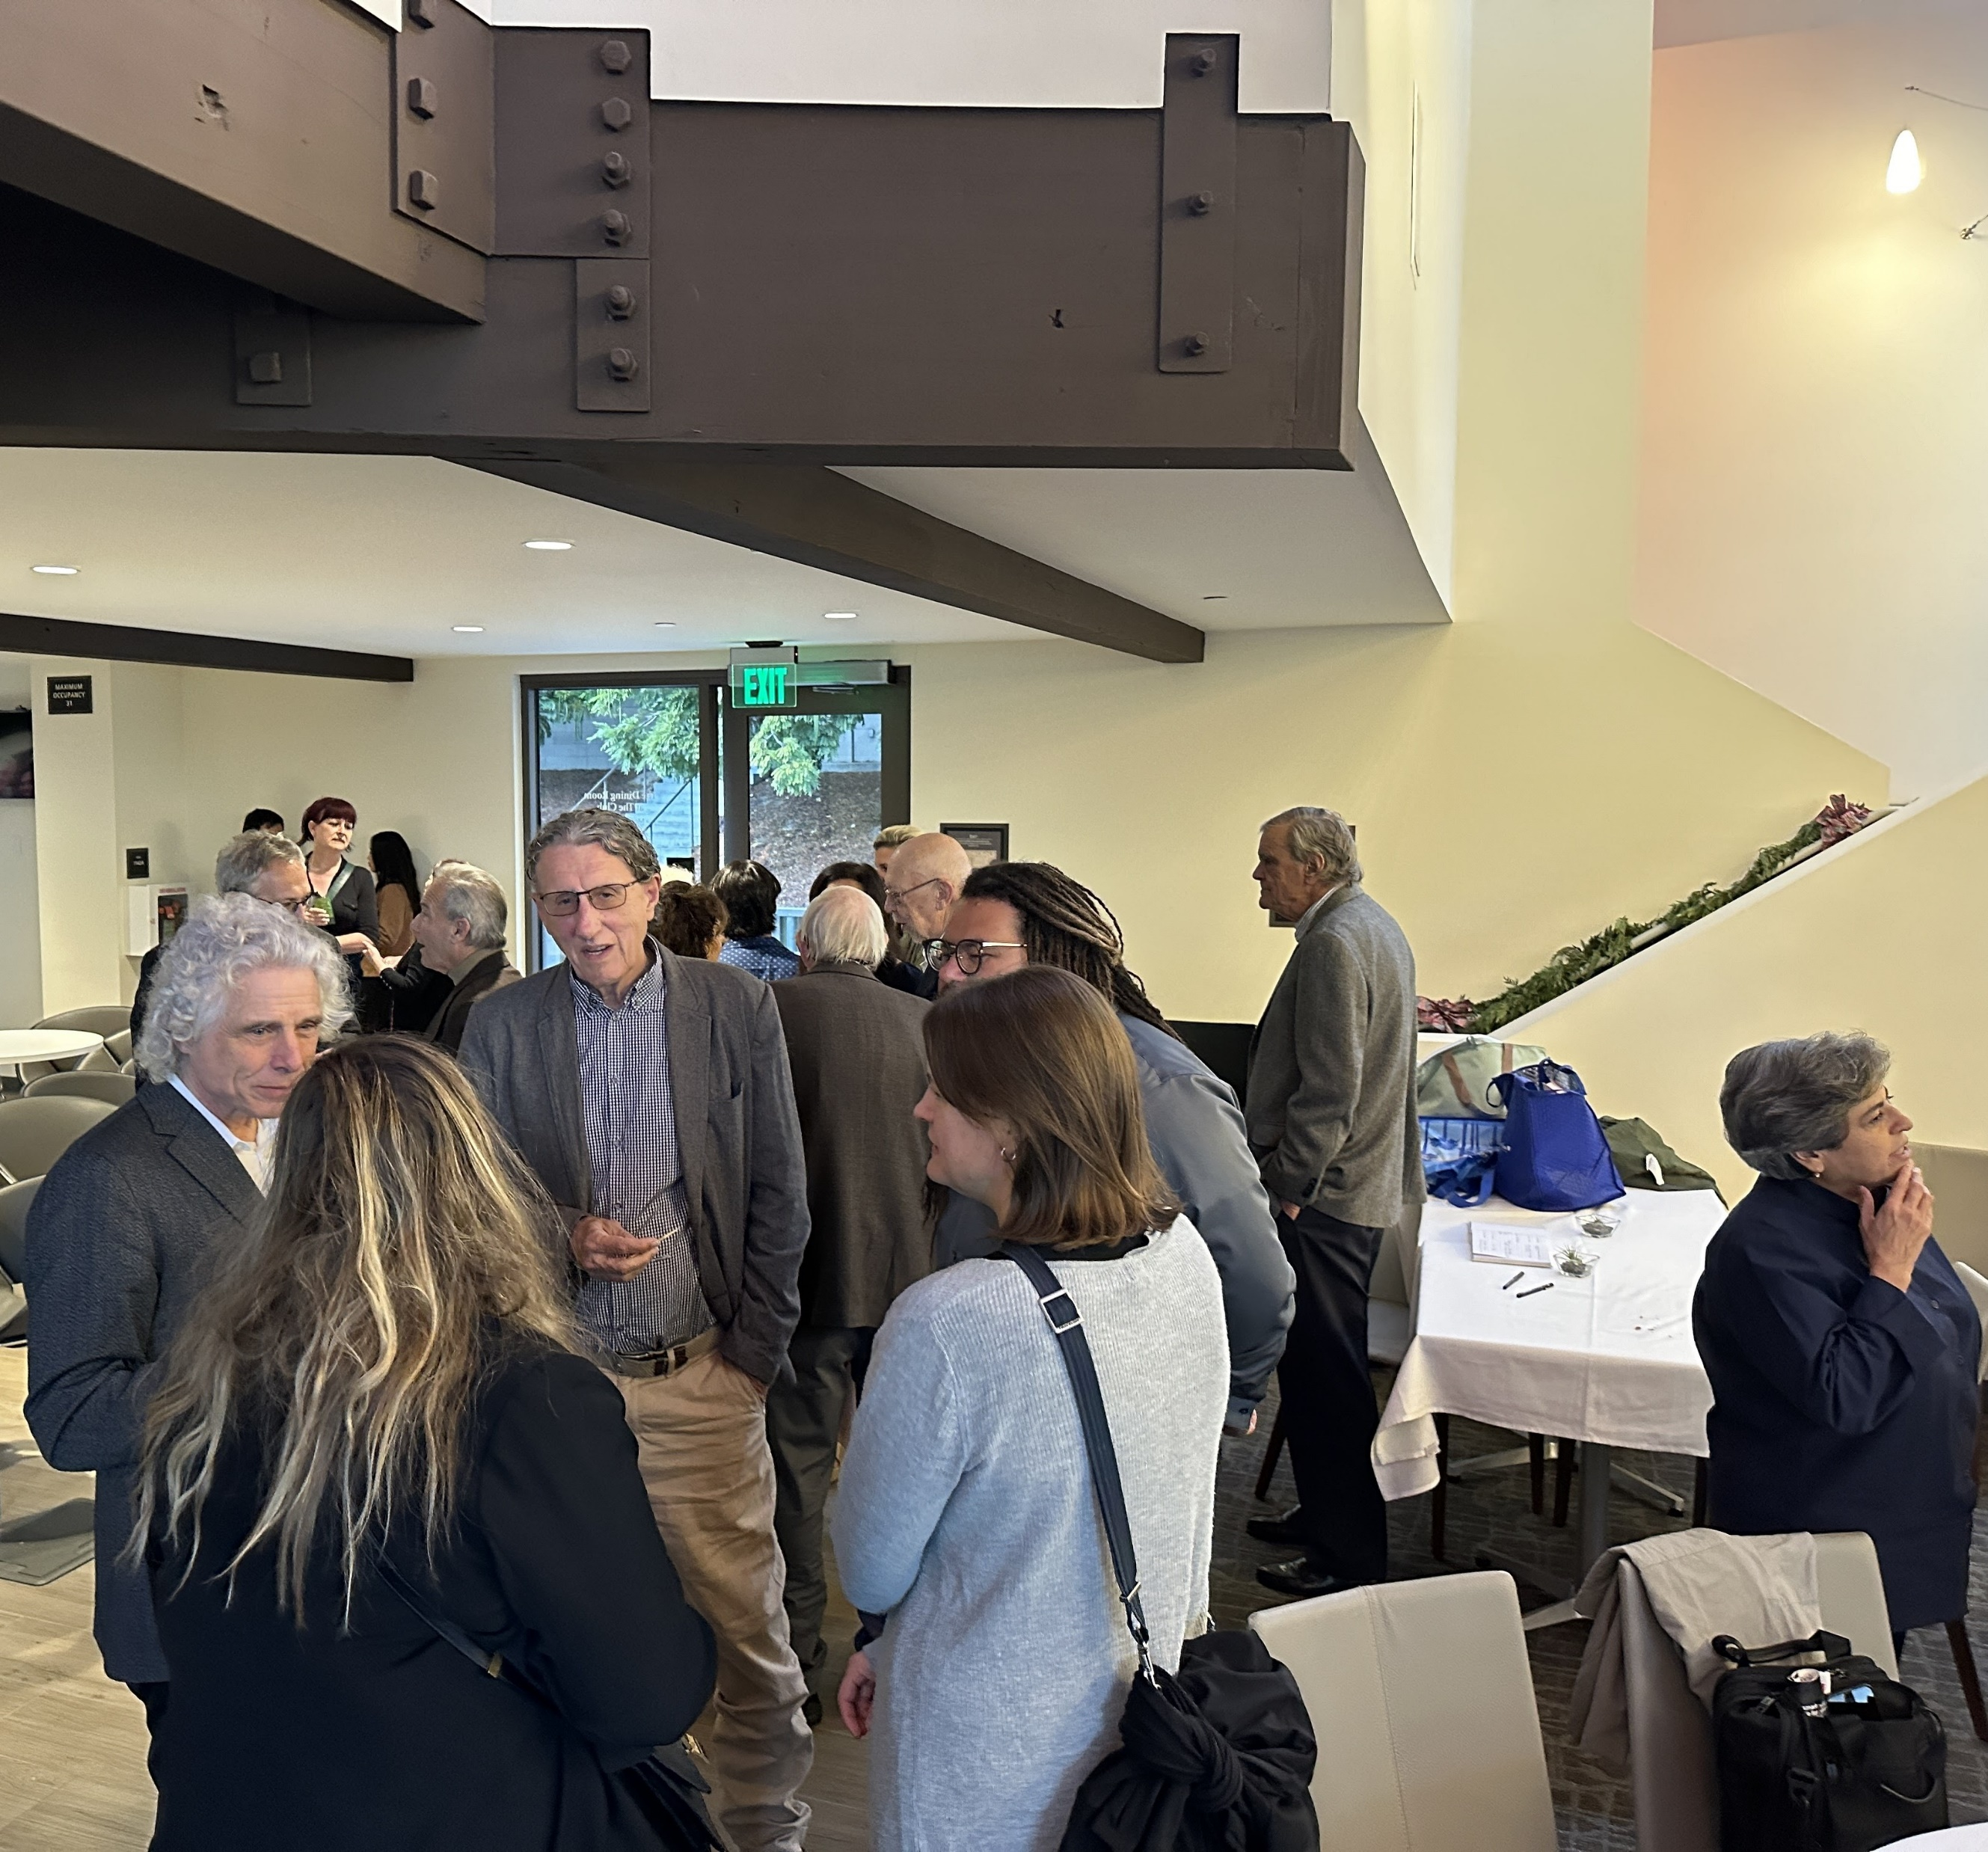
Notes:
L-R: Steve Pinker, Jaimie Krems, Doug Kenrick, Elsa Ermer, Dan Conroy-Beam, Dave Hamilton, Naomi Rustomjee

Slide 29
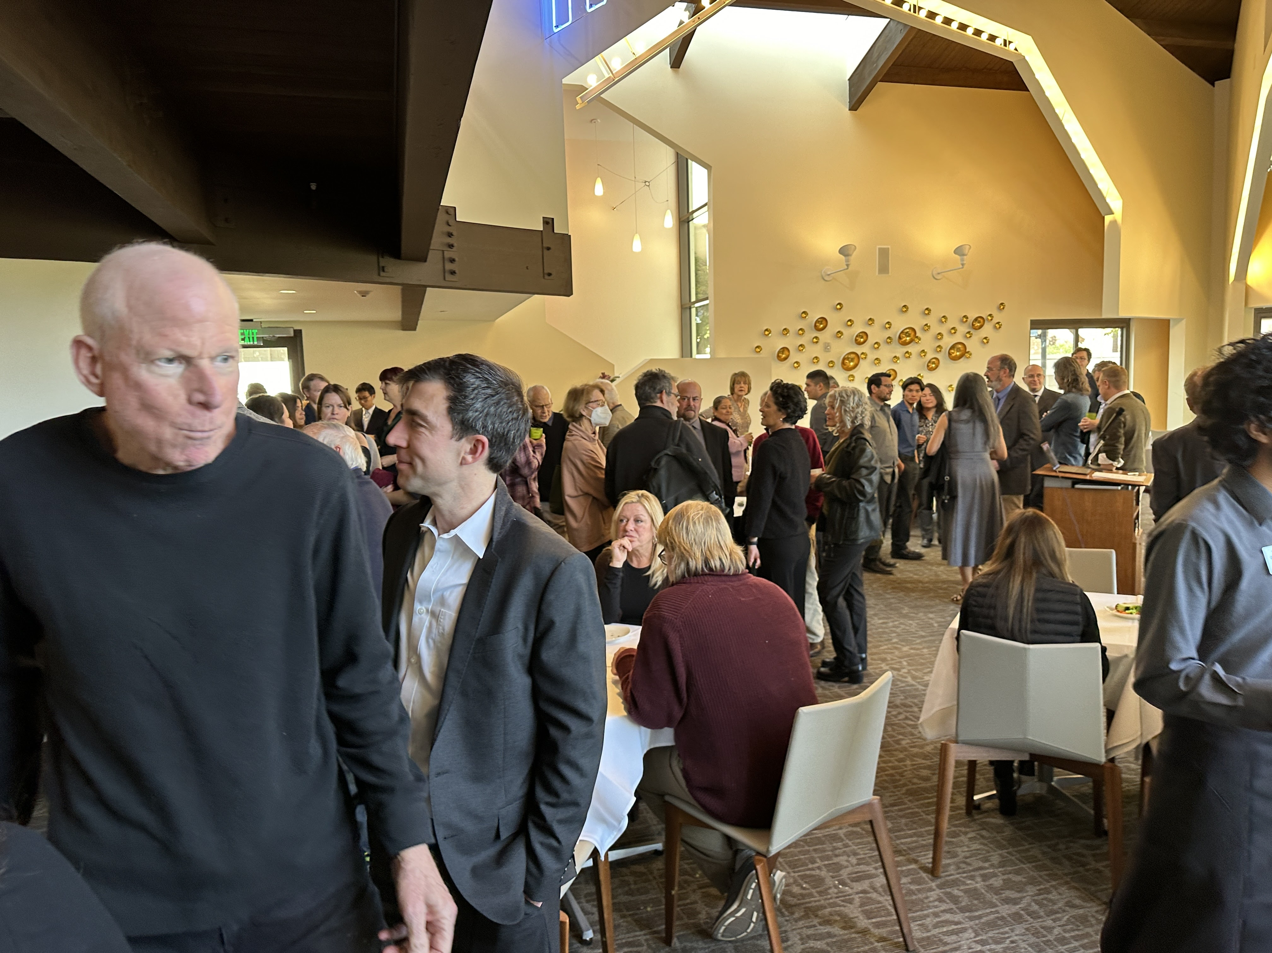
Notes:
David Buss, Dave Pietraszewski on L

Slide 30
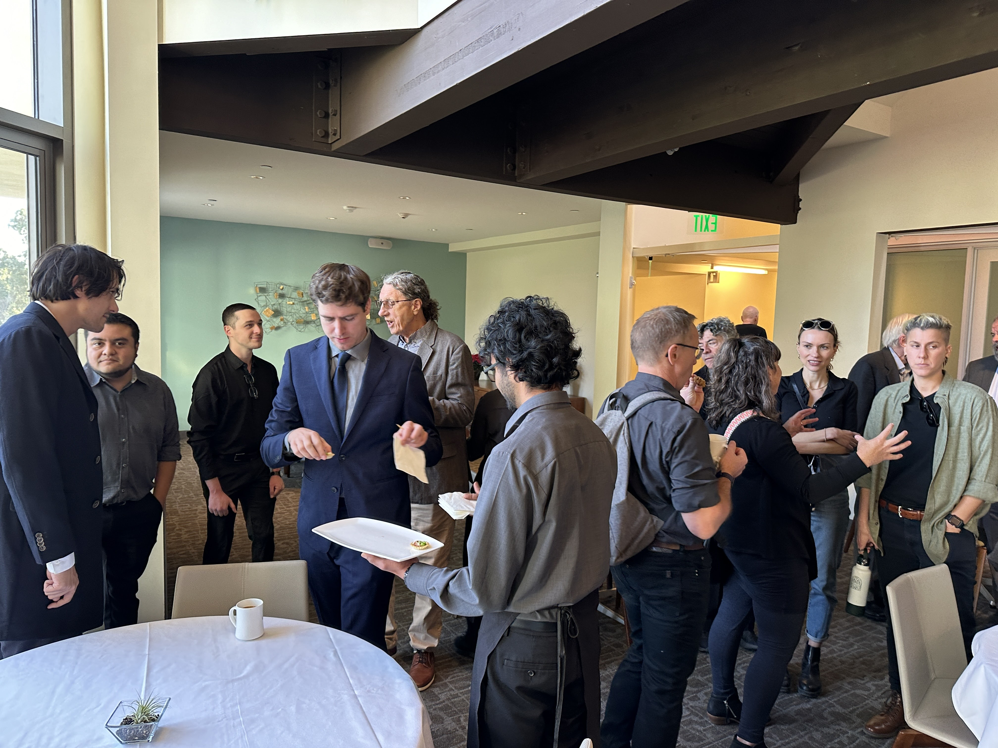
Notes:
In view: Tikal Catena, Leo Jimenez Chavez, Ben Gelbart, Dylan Benkley, Doug Kenrick, Larry Fiddict, Jonathan Schooler, *, Ronnie Bailey-Steinetz

Slide 31
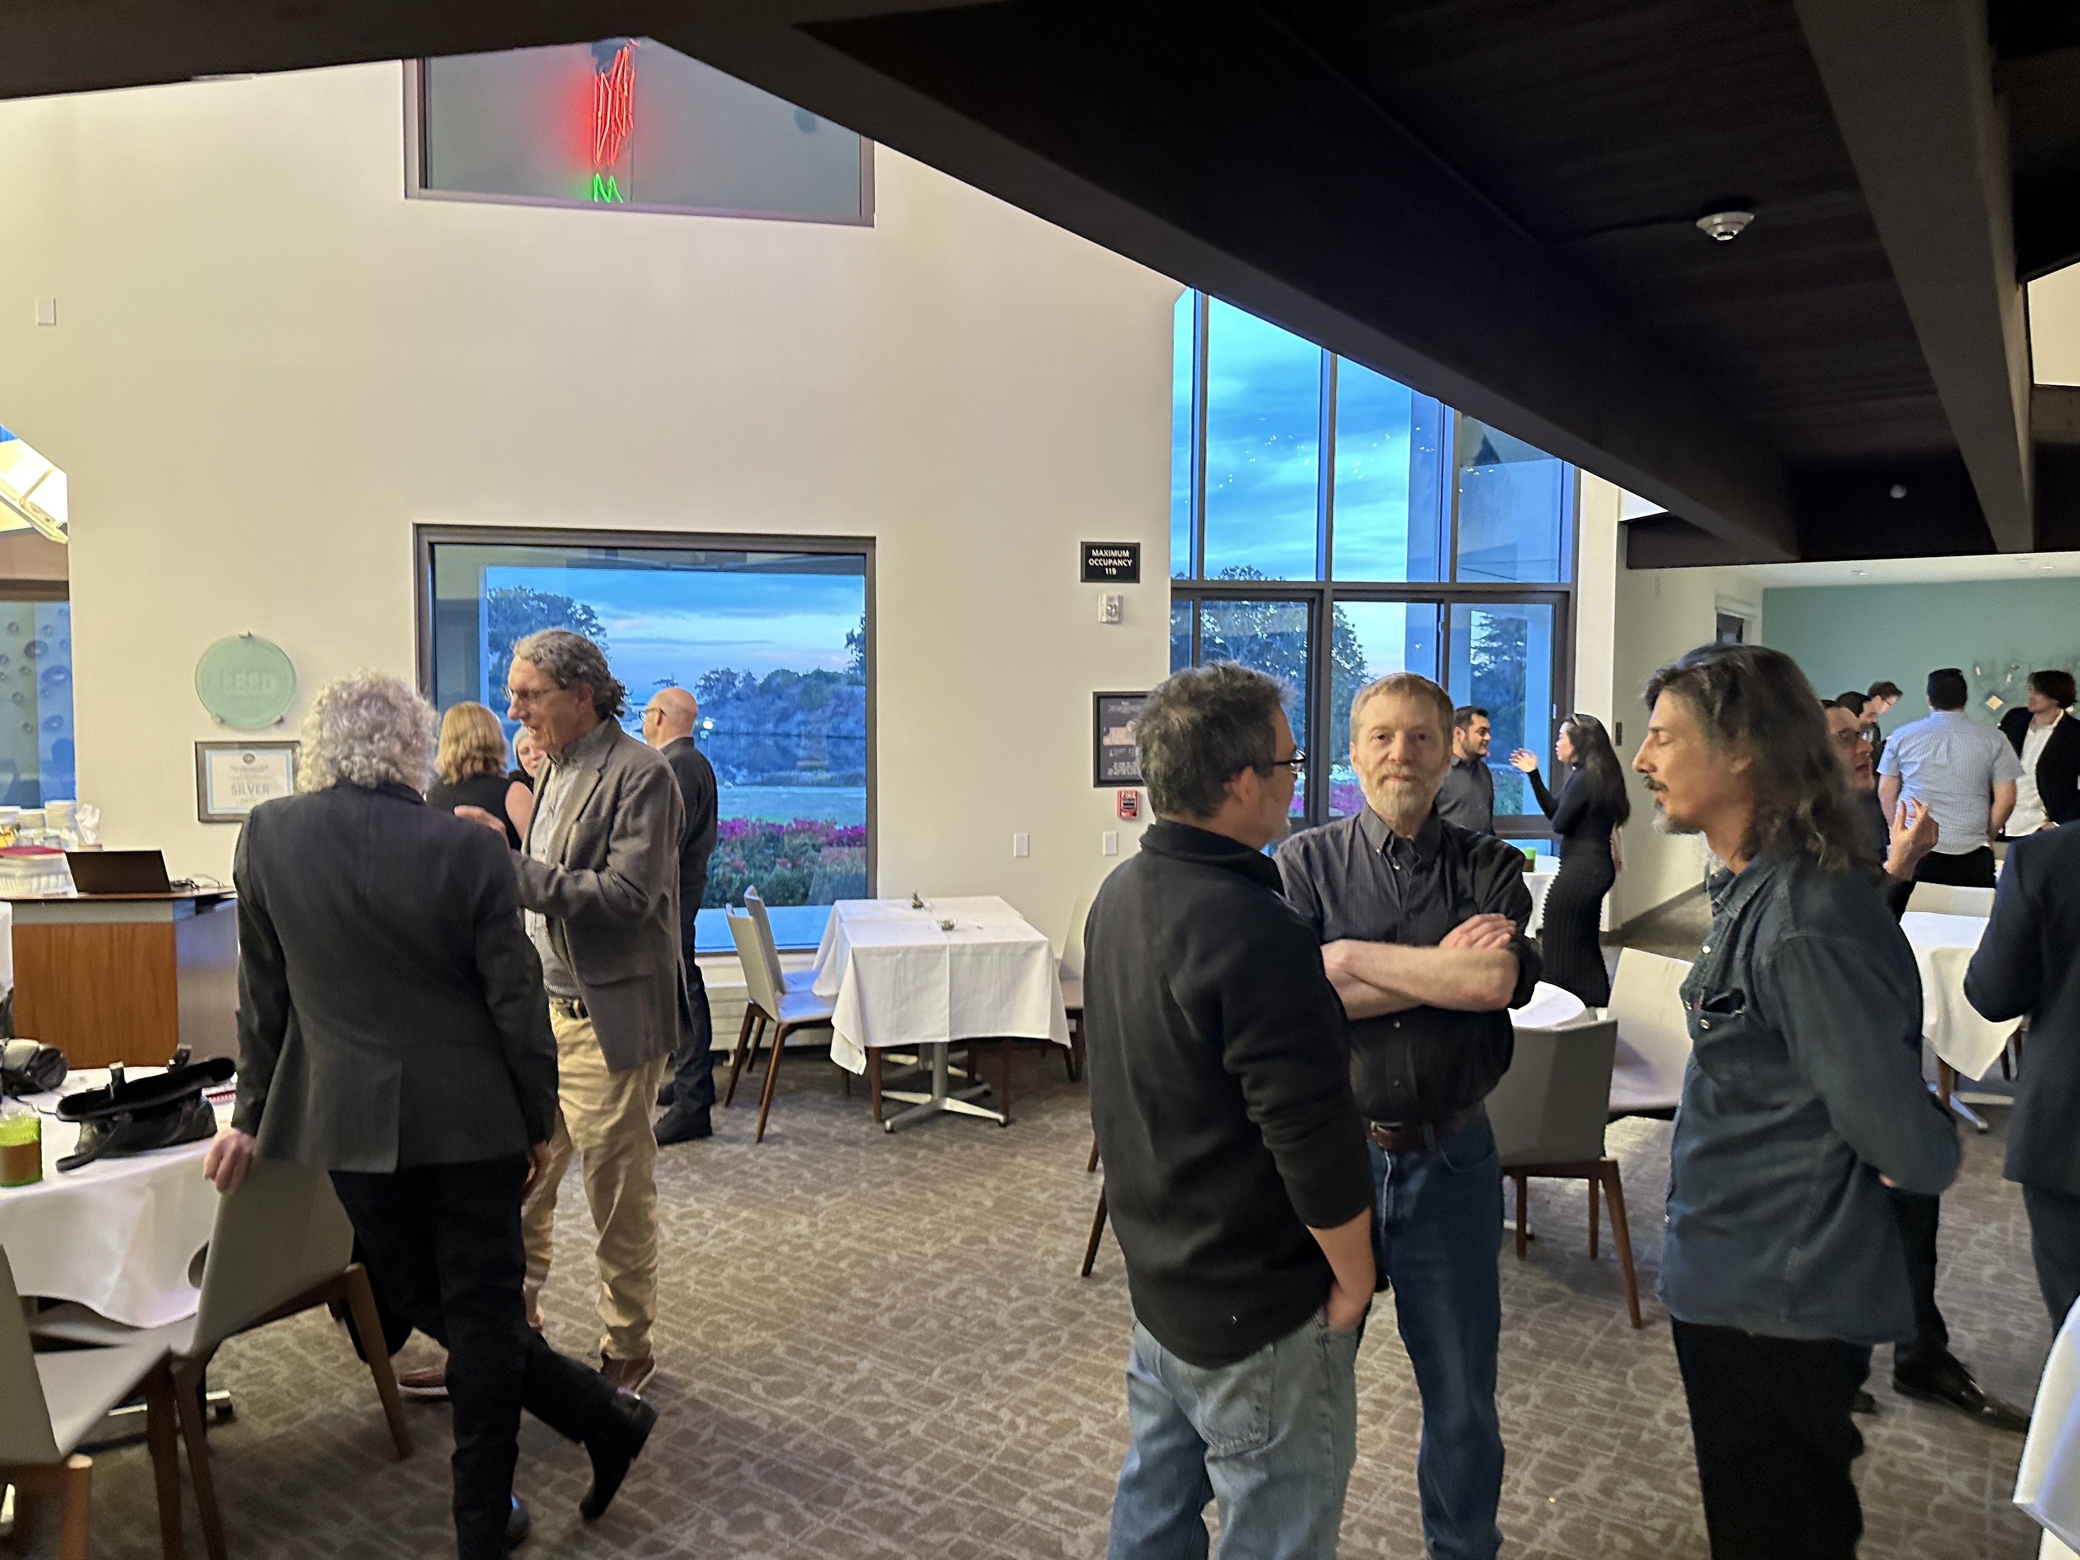
Notes:
R cluster: Larry Sugiyama, Ed Hagen, Eric Schniter

Slide 32
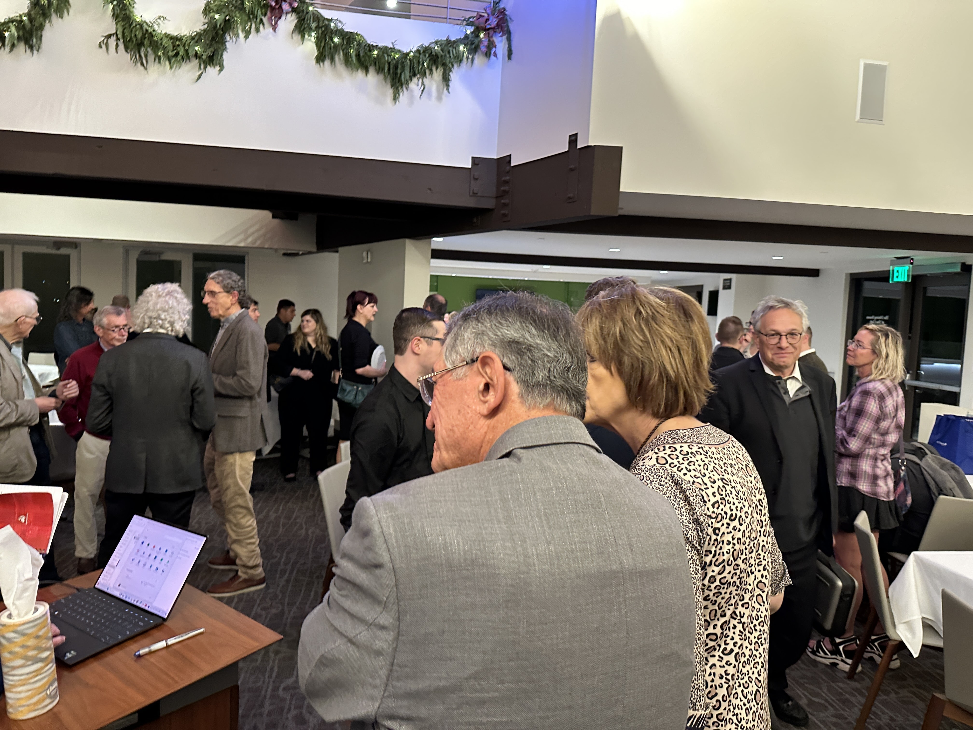
Notes:
George Cosmides and Marian Cosmides, foreground. Martin Daly, Steve Gaulin, Steve Pinker, Doug Kenrick, Jaimie Krems, Tamsin German, Ben Gelbart, Pascal Boyer, Catherine Salmon

Slide 33
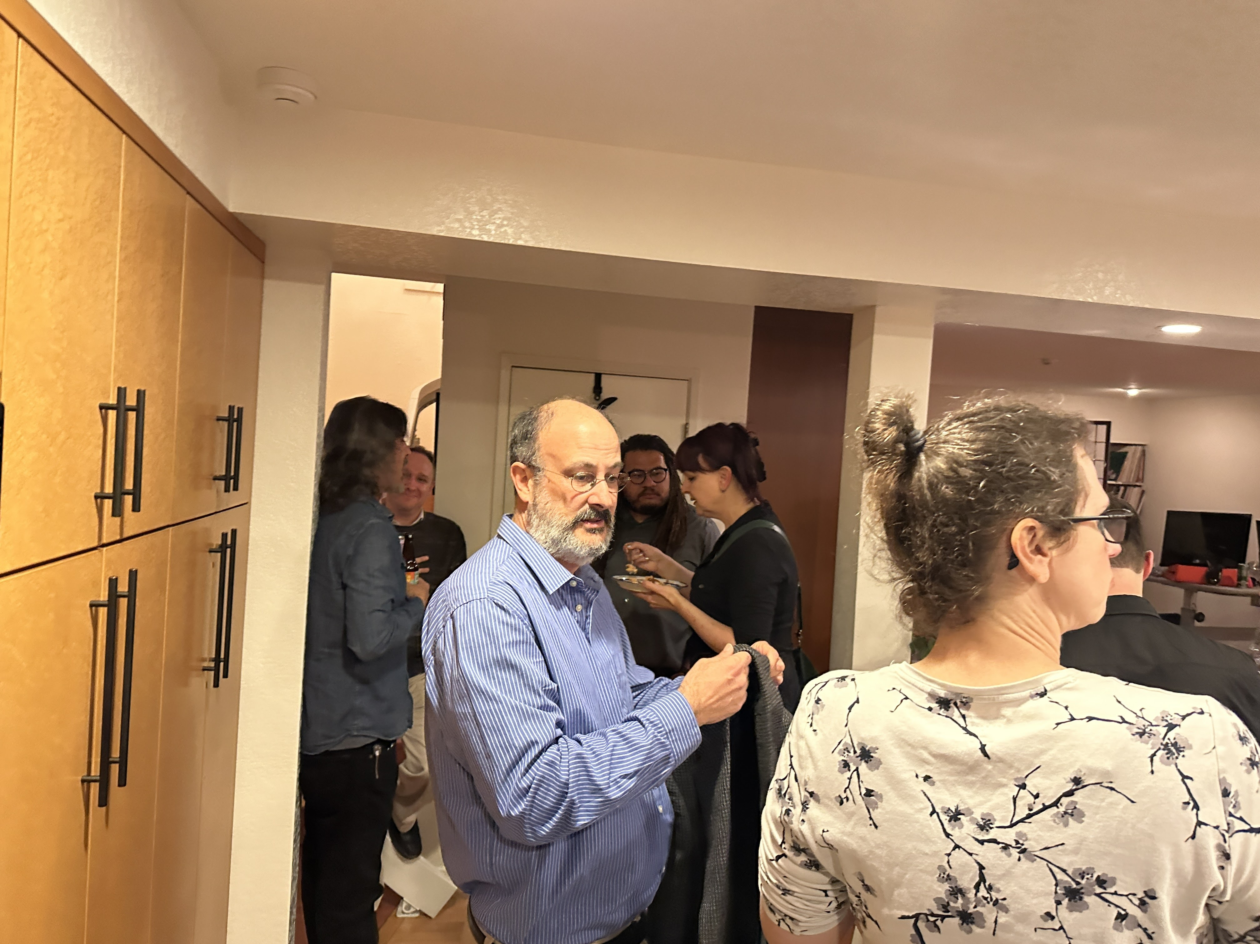
Notes:
Jim Roney, Danielle Truxaw (foreground). Eric Schniter, Max Krasnow, Dan Conroy-Beam, Tamsin German

Slide 34
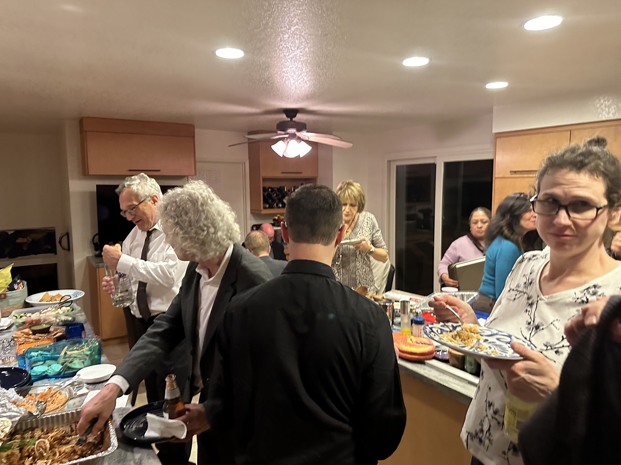

Slide 35
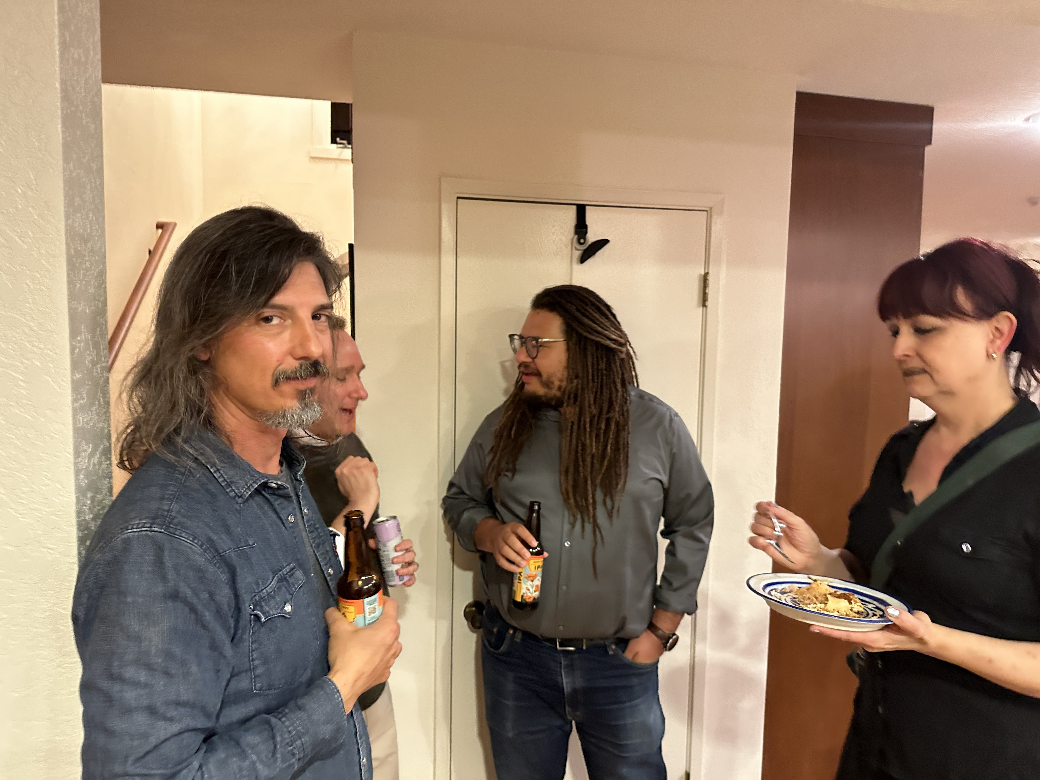

Slide 36
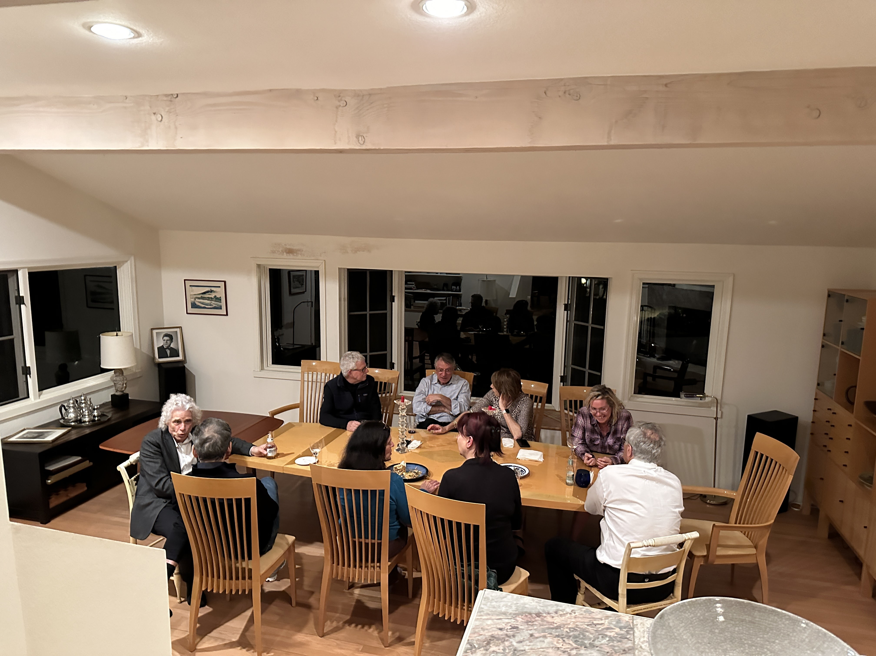

Slide 37
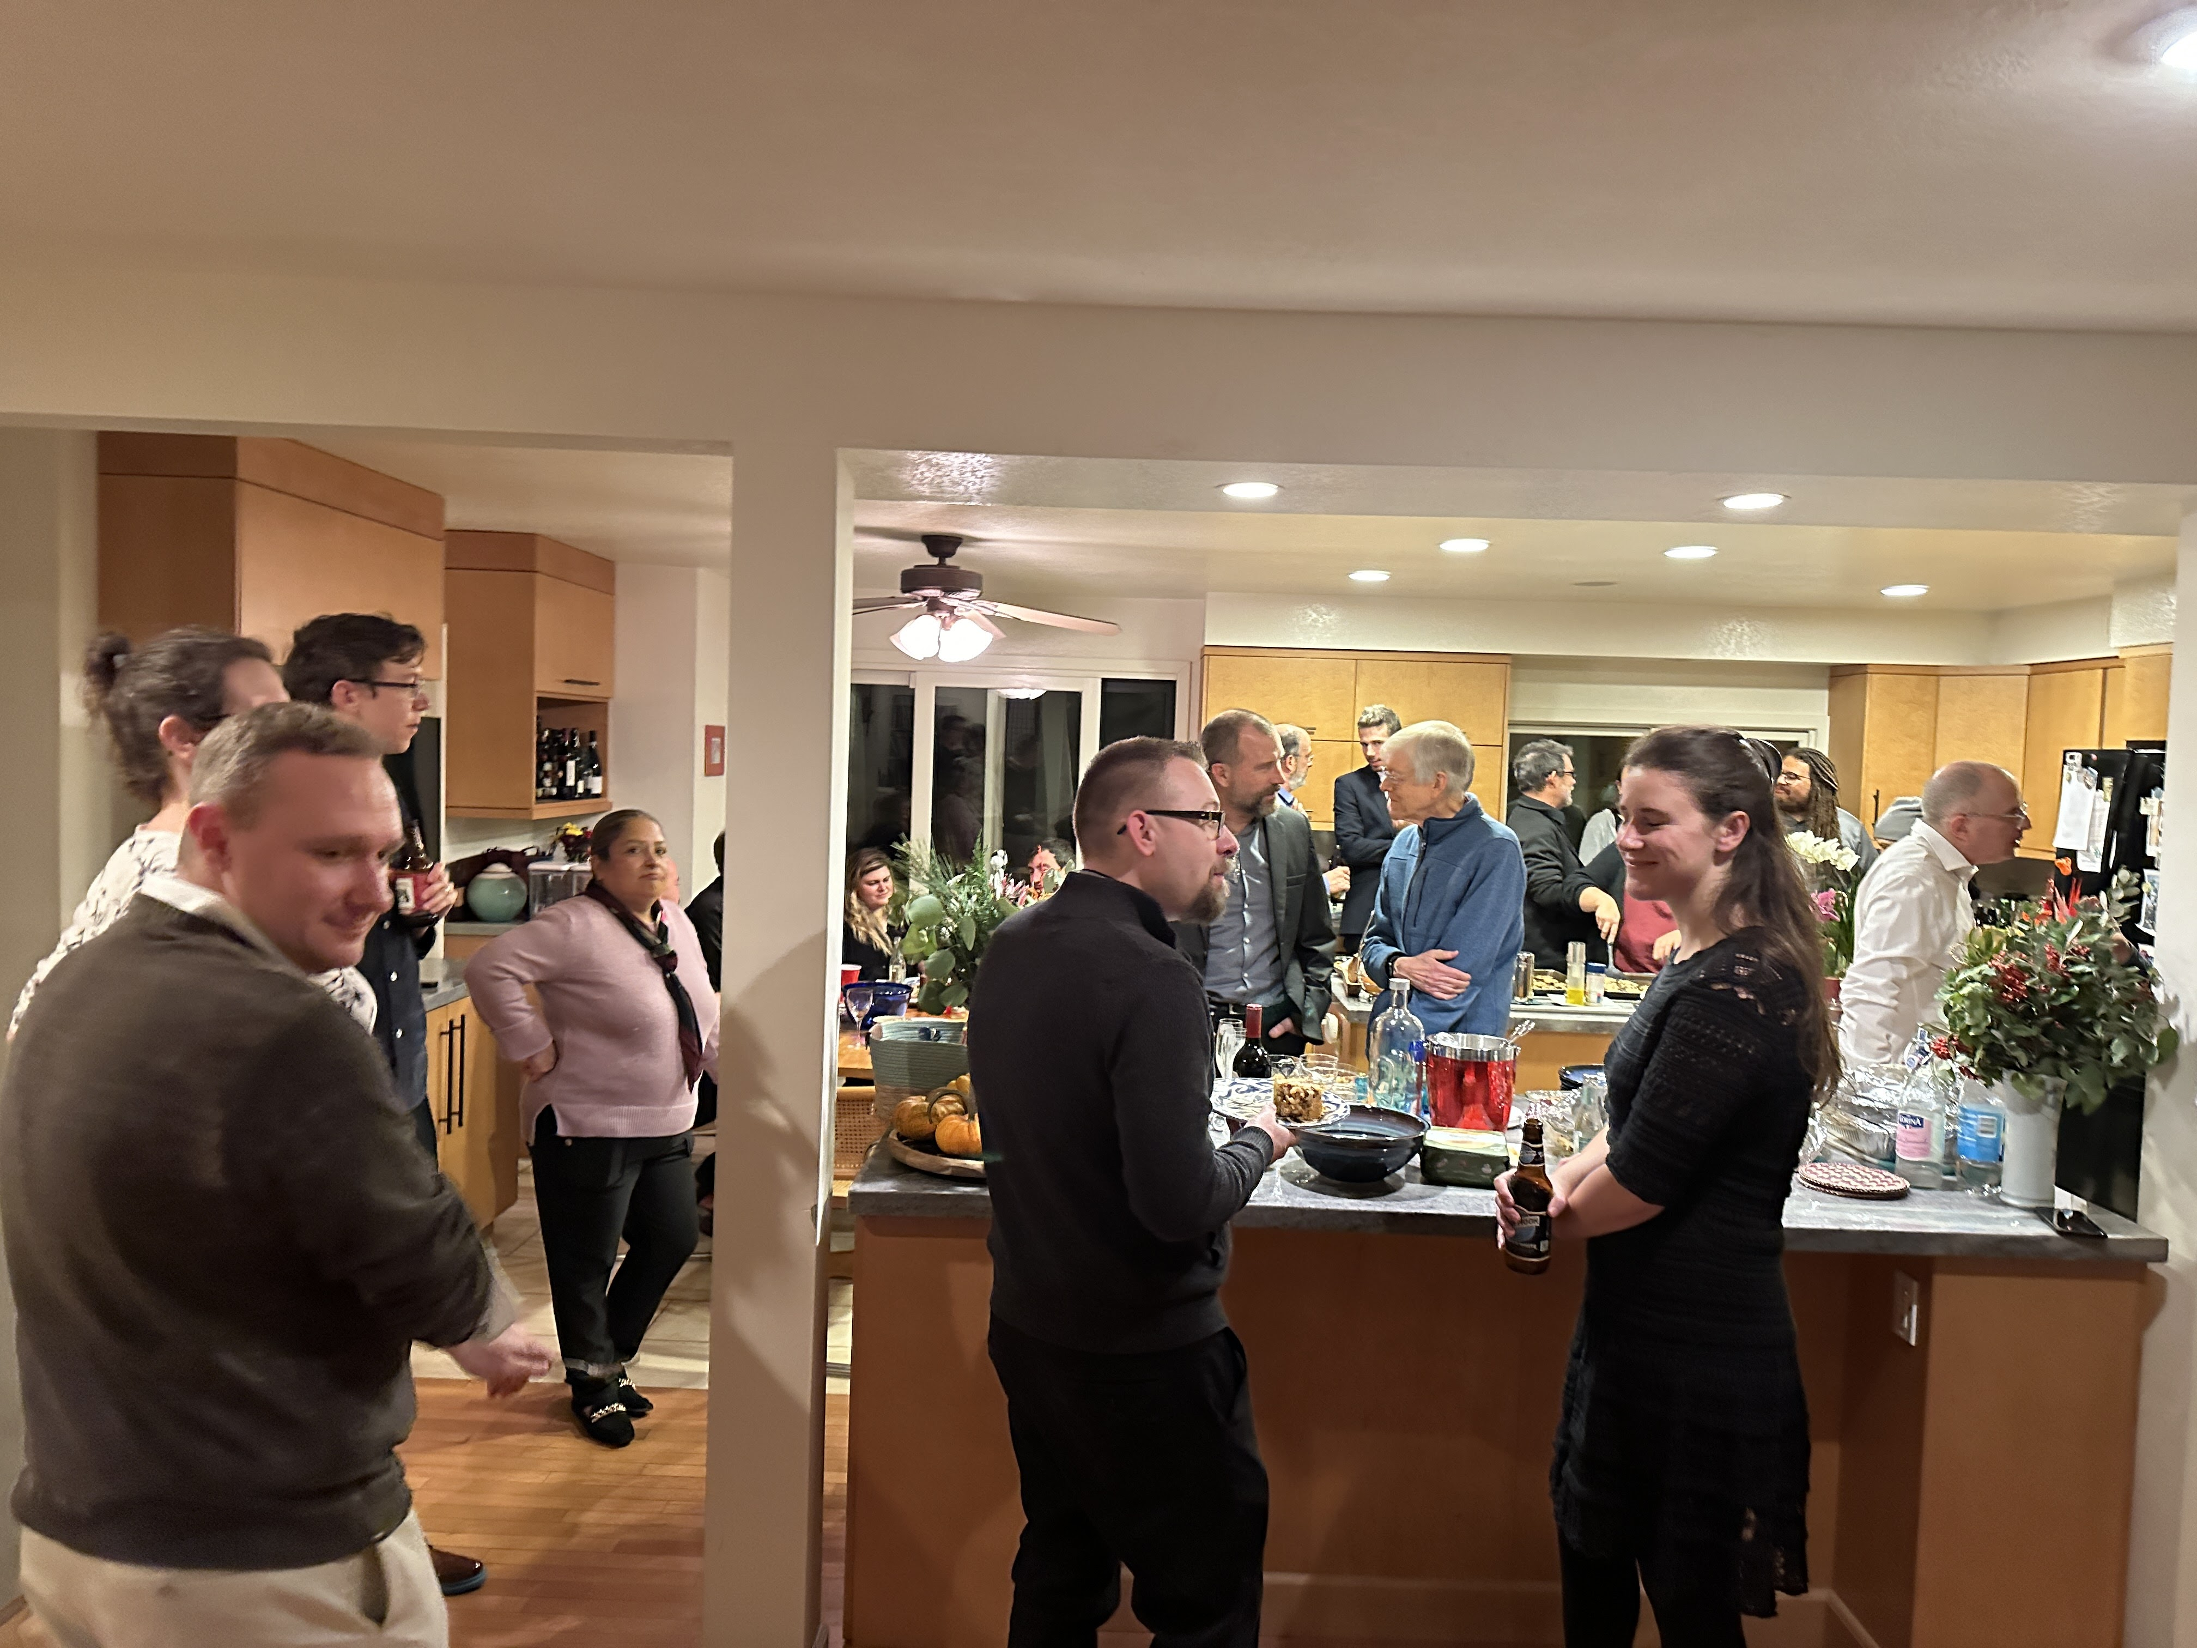

Slide 38
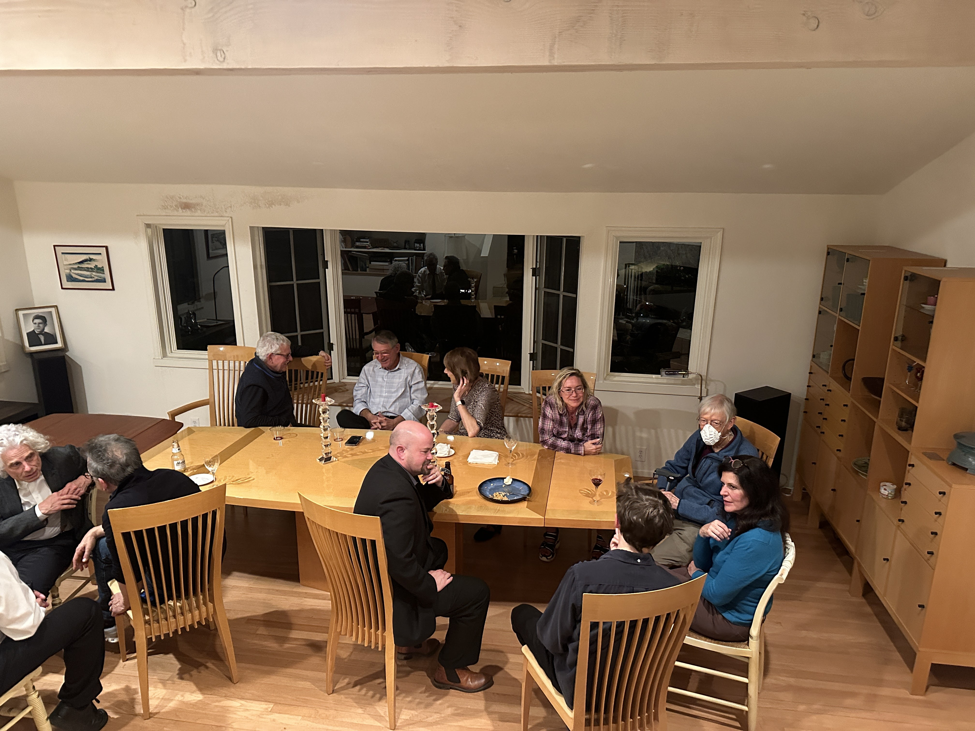

Slide 39
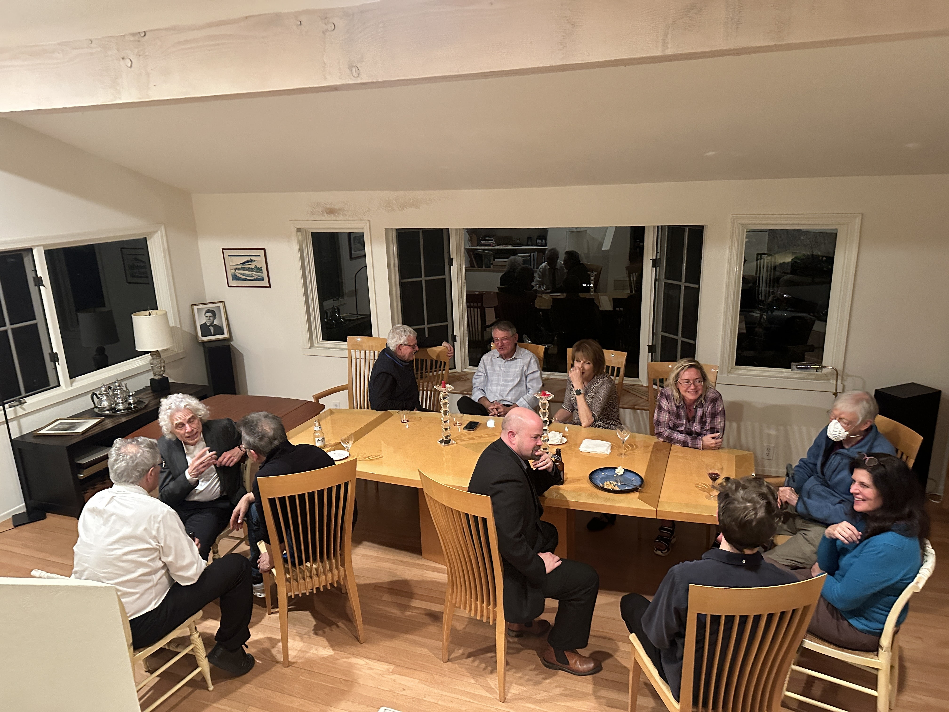

Slide 40
